Slide 1
Biomedical Control Systems (BCS)
Module Leader: Dr Muhammad Arif
Email: muhammadarif13@hotmail.com
Please include “BCS-10BM" in the subject line in all email communications to avoid auto-deleting or junk-filtering.
Batch: 10 BM
Year: 3rd
Term: 2nd
Credit Hours (Theory): 4
Lecture Timings: Monday (12:00-2:00) and Wednesday (8:00-10:00)
Starting Date: 16 July 2012
Office Hour: BM Instrumentation Lab on Tuesday and Thursday (12:00 – 2:00)
Office Phone Ext: 7016

Slide 2
Mathematical Modeling of Mechanical Systems

Slide 3
Learning Outcomes:
After completing this chapter the student will be able to:
Obtain the transfer function of linear translational mechanical systems.
Convert mechanical system into series and parallel circuit analogs.

Slide 4
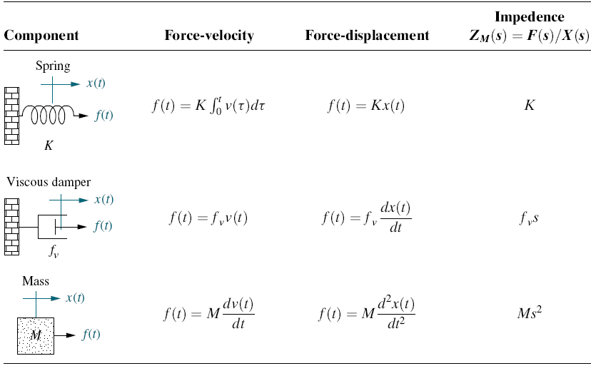
Force-velocity, force-displacement, and impedance relationships for springs, viscous dampers, and mass
where, K, f v, and M are called spring constant, coefficient of viscous friction, and mass, respectively.

Slide 5
Analogies Between Electrical and Mechanical Components
Mechanical systems, like electrical networks, have three passive, linear components.
Two of them, the spring and the mass, are energy-storage elements;
One of them, the viscous damper, dissipates energy.
The two energy-storage elements are analogous to the two electrical energy-storage elements, the inductor and capacitor.
The energy dissipater is analogous to electrical resistance.
The motion of translation is defined as a motion that takes place along a straight or curved path. The variables that are used to describe translational motion are acceleration, velocity, and displacement.

Slide 6
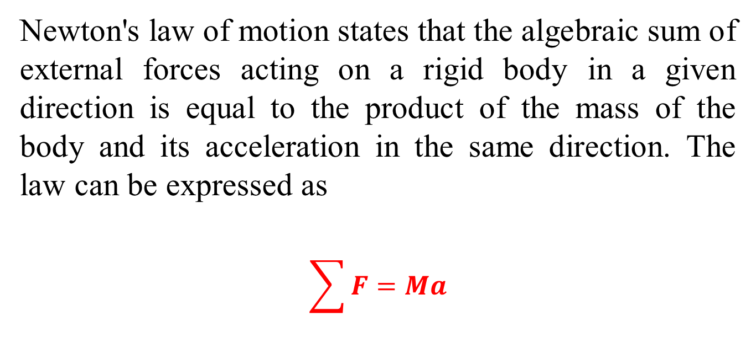
Newton’s Second Law
Newton's law of motion states that the algebraic sum of external forces acting on a rigid body in a given direction is equal to the product of the mass of the body and its acceleration in the same direction. The law can be expressed as
$$\sum{F=Ma}$$

Slide 7
Steps to Obtain the Transfer Function of Mechanical System.
The mechanical system requires just one differential equation, called the equation of motion, to describe it.
Assume a positive direction of motion, for example, to the right.
This assumed positive direction of motion is similar to assuming a current direction in an electrical loop.
First, draw a free-body diagram, placing on the body all forces that act on the body either in the direction of motion or opposite to it.
Second, use Newton’s law to form a differential equation of motion by summing the forces and setting the sum equal to zero.
Finally, assuming zero initial conditions, we take the Laplace transform of the differential equation, separate the variables, and arrive at the transfer function.

Slide 8
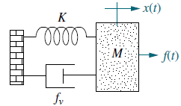
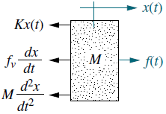
Example-1: Find the transfer function, X(s)/F(s), of the system.
Free Body Diagram (FBD)
First step is to draw the free-body diagram.
Place on the mass all forces felt by the mass.
We assume the mass is traveling toward the right. Thus, only the applied force points to the right; all other forces impede the motion and act to oppose it. Hence, the spring, viscous damper, and the force due to acceleration point to the left.
Second step is to write the differential equation of motion using Newton’s law to sum to zero all of the forces shown on the mass.

Slide 9
Example-1: Continue.
Third step is to take the Laplace transform, assuming zero initial conditions,
Finally, solving for the transfer function yields
Block Diagram

Slide 10
Impedance Approach to Obtain the Transfer Function of Mechanical System.
Taking the Laplace transform of the force-displacement terms of mechanical components , we get
We can define impedance for mechanical components as
For the spring,
For the viscous damper,
and for the mass,

Slide 11
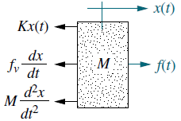
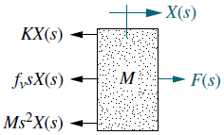
Example-2: Solve example-1 using the Impedance Approach.
Summing the forces in the Laplace Transformed FBD, we get
Which is in the form of
Laplace Transformed FBD

Slide 12
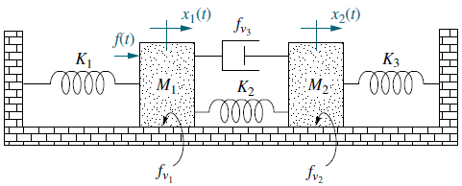
Example-3: Find the transfer function, X₂(s)/F(s), of the system.
The system has two degrees of freedom, since each mass can be moved in the horizontal direction while the other is held still.
Thus, two simultaneous equations of motion will be required to describe the system.
The two equations come from free-body diagrams of each mass.
Superposition is used to draw the free body diagrams.
For example, the forces on M1 are due to (1) its own motion and (2) the motion of M2 transmitted toM1 through the system.
We will consider these two sources separately.

Slide 13
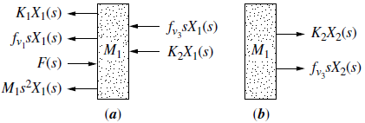
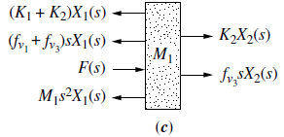
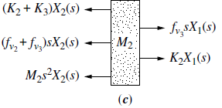
Example-3: Continue.
Case-I: Forces on M1
All forces on M1
Combine (a) & (b)
Figure-1.
Case-II: Forces on M2
All forces on M2
Combine (a) & (b)
Figure-2.

Slide 14
Example-3: Continue.
Case-I: Forces on M1
If we hold M2 still and move M1 to the right, we see the forces shown in Figure-1.
The total force on M1 is the superposition, or sum of the forces, as shown in Figure-1(c).
All forces on M1
Combine (a) & (b)
Figure-1:
a. Forces on M1 due only to motion of M1;
b. forces on M1 due only to motion of M2;
c. all forces on M1.
The Laplace transform of the equations of motion can be written from Figure-1 (c) as;
(1)

Slide 15
Example-3: Continue.
Case-II: Forces on M2
If we hold M1 still and move M2 to the right, we see the forces shown in Figure-2.
For M2, First we move M2 to the right while holding M1 still;
then we move M1 to the right and hold M2 still.
For each case we evaluate the forces on M2.
All forces on M2
Combine (a) & (b)
Figure-2:
a. Forces on M2 due only to motion of M2;
b. forces on M2 due only to motion of M1;
c. all forces on M2.
The Laplace transform of the equations of motion can be written from Figure-2 (c) as;
(2)

Slide 16
Example-3: Continue.
(1)
(2)
From equation (1) and (2), the transfer function, X2(s)/F(s), is
Where,
Block Diagram

Slide 17
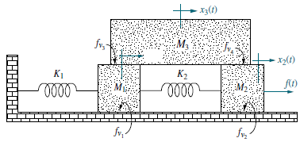
Example-4: Write, but do not solve, the equations of motion for the mechanical network shown below.
The system has three degrees of freedom, since each of the three masses can be moved independently while the others are held still.
M1 has two springs, two viscous dampers, and mass associated with its motion.
There is one spring between M1 and M2 and one viscous damper between M1 and M3.

Slide 18
Electric Circuit Analogs
An electric circuit that is analogous to a system from another discipline is called an electric circuit analog.
The mechanical systems with which we worked can be represented by equivalent electric circuits.
Analogs can be obtained by comparing the equations of motion of a mechanical system, with either electrical mesh or nodal equations.
When compared with mesh equations, the resulting electrical circuit is called a series analog.
When compared with nodal equations, the resulting electrical circuit is called a parallel analog.

Slide 19
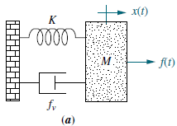
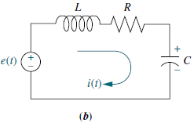
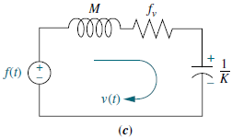
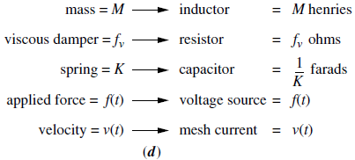
Series Analog
For a direct analogy b/w Eq (1) & (2), convert displacement to velocity by divide and multiply the left-hand side of Eq (1) by s, yielding;
Equation of motion of the above translational mechanical system is;
Kirchhoff’s mesh equation for the above simple series RLC network is;
(1)
(2)
(3)
Comparing Eqs. (2) & (3), we recognize the sum of impedances & draw the circuit shown in Figure (c). The conversions are summarized in Figure (d).

Slide 20
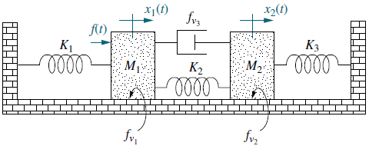
Converting a Mechanical System to a Series Analog
Example-5: Draw a series analog for the mechanical system.
The equations of motion in the Laplace transform domain are;
(1)
(2)
Eqs (1) & (2) are analogous t0 electrical mesh equations after conversion to velocity. Thus,
(3)
(4)

Slide 21
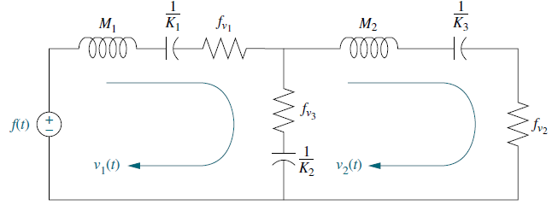
Example-5: Continue.
(3)
(4)
Coefficients represent sums of electrical impedance.
Mechanical impedances associated withM1 form the first mesh,
whereas impedances between the two masses are common to the two loops.
Impedances associated with M2 form the second mesh.
The result is shown in Figure below, where v1(t) and v2(t) are the velocities of M1 and M2, respectively.

Slide 22
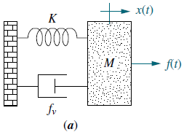
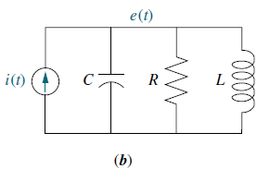
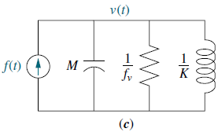
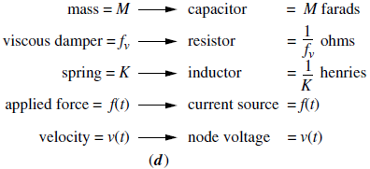
Parallel Analog
Equation of motion of the above translational mechanical system is;
Kirchhoff’s nodal equation for the simple parallel RLC network shown above is;
(1)
(2)
Comparing Eqs. (1) & (2), we identify the sum of admittances & draw the circuit shown in Figure (c).
The conversions are summarized in Figure 2.43(d).

Slide 23
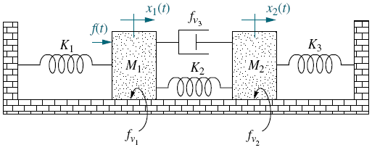
Example-6: Draw a parallel analog for the mechanical system.
Converting a Mechanical System to a Parallel Analog
Equations of motion after conversion to velocity are;
(1)
(2)

Slide 24
Example-6: Continue.
(1)
(2)
The Equation (1) and (2) are also analogous to electrical node equations.
Coefficients represent sums of electrical admittances.
Admittances associated with M1 form the elements connected to the first node,
whereas mechanical admittances b/w the two masses are common to the two nodes.
Mechanical admittances associated with M2 form the elements connected to the second node.
The result is shown in the Figure below, where v1(t) and v2(t) are the velocities of M1 and M2, respectively.

