Slide 1
Biomedical Control Systems (BCS)
Module Leader: Dr Muhammad Arif
Email: muhammadarif13@hotmail.com
Please include “BCS-10BM" in the subject line in all email communications to avoid auto-deleting or junk-filtering.
Batch: 10 BM
Year: 3rd
Term: 2nd
Credit Hours (Theory): 4
Lecture Timings: Monday (12:00-2:00) and Wednesday (8:00-10:00)
Starting Date: 16 July 2012
Office Hour: BM Instrumentation Lab on Tuesday and Thursday (12:00 – 2:00)
Office Phone Ext: 7016

Slide 2
Block Diagrams

Slide 3
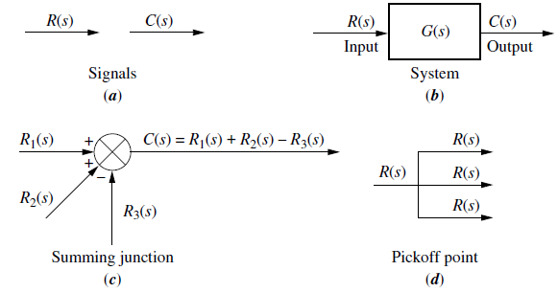
Components of a Block Diagram for a Linear Time Invariant System

Slide 4
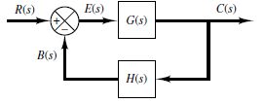
Open-Loop Transfer Function and Feed-forward Transfer Function
The ratio of the feedback signal B(s) to the actuating error signal E(s) is called the open-loop transfer function. That is,
The ratio of the output C(s) to the actuating error signal E(s) is called the feed-forward transfer function, so that
If the feedback transfer function H(s) is unity, then the open-loop transfer function and the feed-forward transfer function are the same.

Slide 5
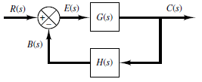
Closed-Loop Transfer Function
The output C(s) and input R(s) are related as follows: since
Eliminating E(s) from these equations gives
The transfer function relating C(s) to R(s) is called the closed-loop transfer function.
C(s) is given by

Slide 6
Cascade Form:
Figure:
a) Cascaded Subsystems.
b) Equivalent Transfer Function.
The equivalent transfer function is

Slide 7
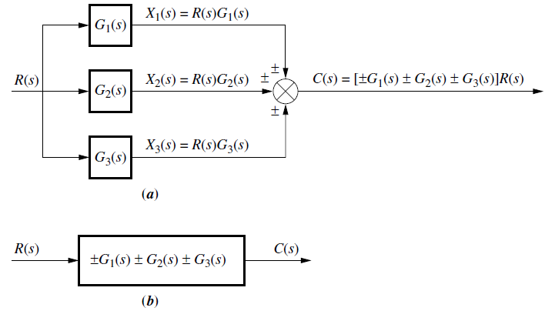
Parallel Form:
Figure:
a) Parallel Subsystems.
b) Equivalent Transfer Function.
The equivalent transfer function is

Slide 8
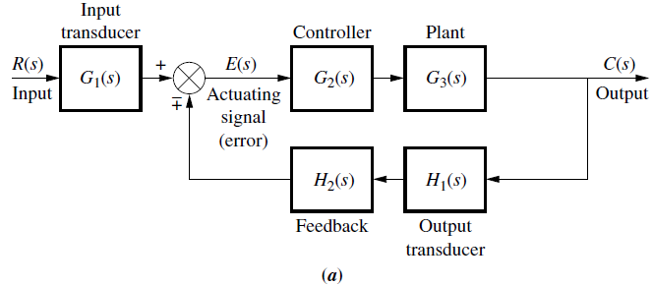
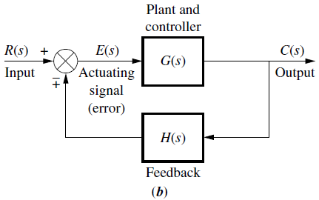
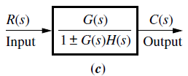
Feedback Form:
Figure:
Feedback Control System.
Simplified Model.
c) Equivalent Transfer Function.
The equivalent or closed-loop
transfer function is

Slide 9
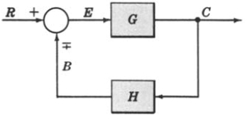
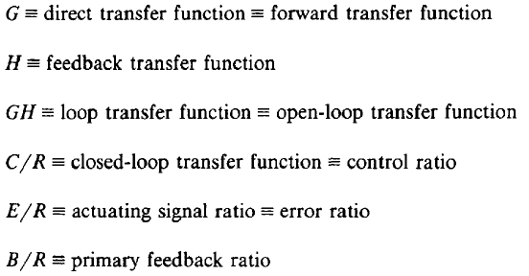
Canonical Form of A Feedback Control System

Slide 10
Characteristic Equation

Slide 11
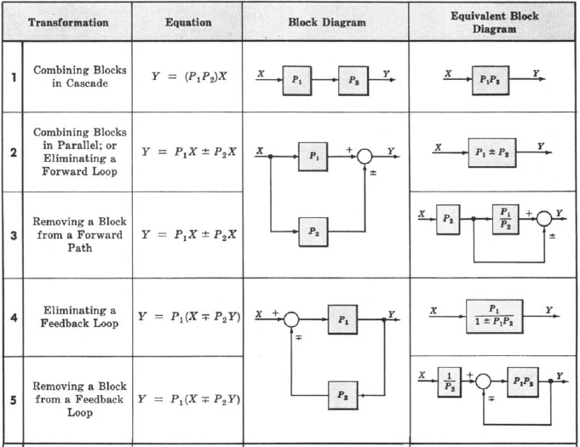
Block Diagram Transformation Theorems

Slide 12
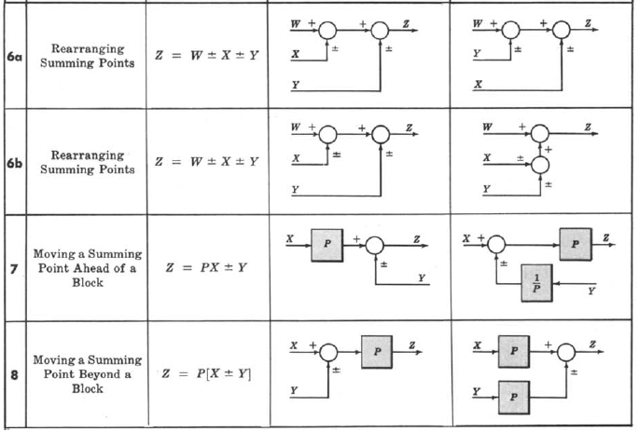
Transformation Theorems Continue:

Slide 13
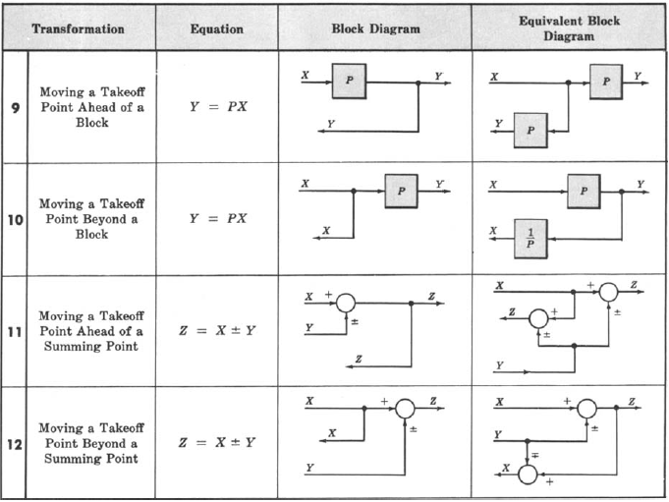
Transformation Theorems Continue:

Slide 14
Unity Feedback System

Slide 15
Superposition of Multiple Inputs

Slide 16
Example-1: Multiple Input System. Determine the output C due to inputs R and U using the Superposition Method.

Slide 17
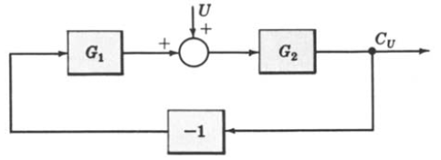
Example-1: Continue.

Slide 18
Example-1: Continue.

Slide 19
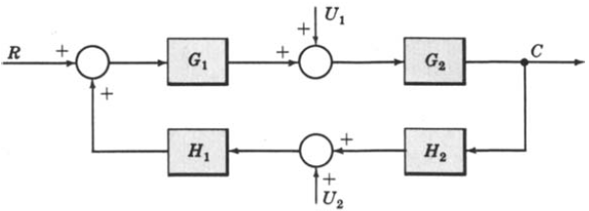
Example-2: Multiple-Input System. Determine the output C due to inputs R, U1 and U2 using the Superposition Method.

Slide 20
Example-2: Continue.

Slide 21
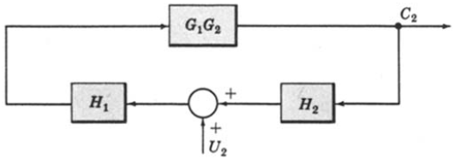
Example-2: Continue.

Slide 22
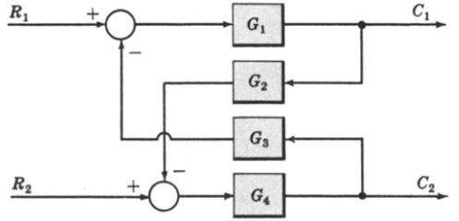
Example-3: Multi-Input Multi-Output System. Determine C1 and C2 due to R1 and R2.

Slide 23
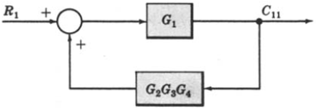
Example-3: Continue.

Slide 24
Example-3: Continue.
When R1 = 0,
When R2 = 0,

Slide 25
Reduction of Complicated Block Diagrams:

Slide 26
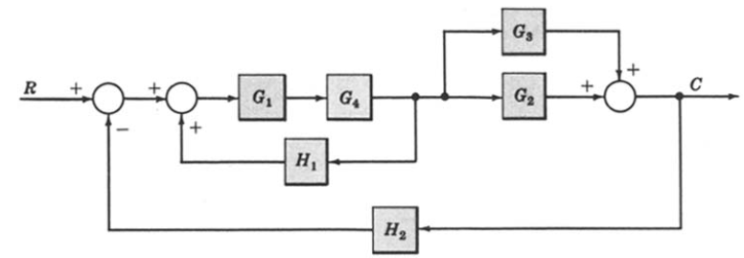
Example-4: Reduce the Block Diagram to Canonical Form.

Slide 27
Example-4: Continue.
However in this example step-4 does not apply.
However in this example step-6 does not apply.

Slide 28
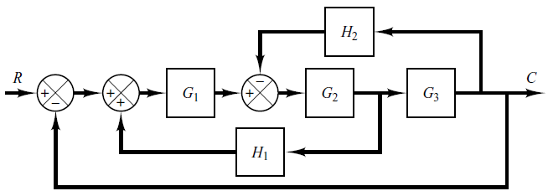
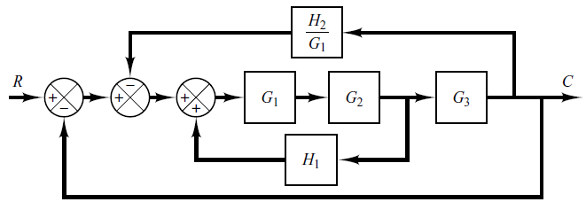
Example-5: Simplify the Block Diagram.

Slide 29
Example-5: Continue.

Slide 30
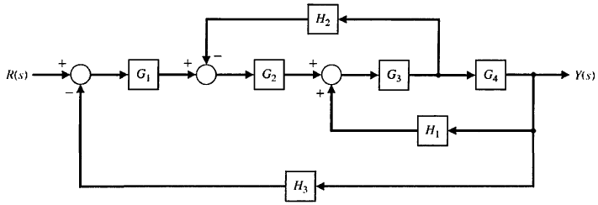
Example-6: Reduce the Block Diagram.

Slide 31
Example-6: Continue.

Slide 32
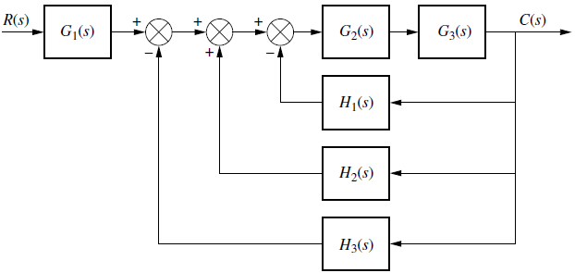
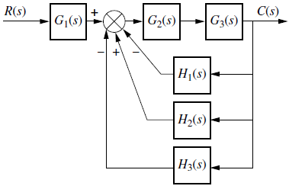
Example-7: Reduce the Block Diagram. (from Nise: page-242)

Slide 33
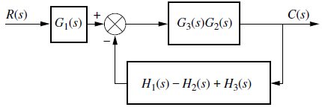
Example-7: Continue.

Slide 34
Example-8: Reduce the system to a single transfer function. (from Nise:page-243).

Slide 35
Example-8: Continue.

Slide 36
Example-8: Continue.

Slide 37
Example-9: Simplify the block diagram then obtain the close-loop transfer function C(S)/R(S). (from Ogata: Page-47)

Slide 38
Example-9: Continue.

Slide 39
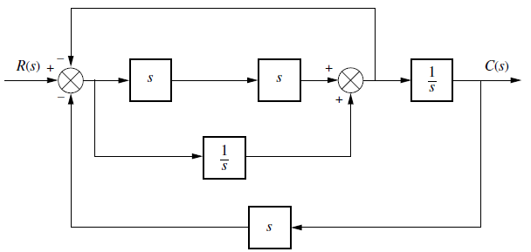
Skill Assessment Exercise:

Slide 40
Answer of Skill Assessment Exercise:

