Slide 1
Biomedical Control Systems (BCS)
Module Leader: Dr Muhammad Arif
Email: muhammadarif13@hotmail.com
Please include “BCS-10BM" in the subject line in all email communications to avoid auto-deleting or junk-filtering.
Batch: 10 BM
Year: 3rd
Term: 2nd
Credit Hours (Theory): 4
Lecture Timings: Monday (12:00-2:00) and Wednesday (8:00-10:00)
Starting Date: 16 July 2012
Office Hour: BM Instrumentation Lab on Tuesday and Thursday (12:00 – 2:00)
Office Phone Ext: 7016

Slide 2
The Bode Plot
A Frequency Response Analysis Technique

Slide 3
The Bode Plot
The Bode plot is a most useful technique for hand plotting was developed by H.W. Bode at Bell Laboratories between 1932 and 1942.
This technique allows plotting that is quick and yet sufficiently accurate for control systems design.
The idea in Bode’s method is to plot magnitude curves using a logarithmic scale and phase curves using a linear scale.
The Bode plot consists of two graphs:
i. A logarithmic plot of the magnitude of a transfer function.
ii. A plot of the phase angle.
Both are plotted against the frequency on a logarithmic scale.
The standard representation of the logarithmic magnitude of G(jw) is 20log|G(jw)| where the base of the logarithm is 10, and the unit is in decibel (dB).

Slide 4
Advantages of the Bode Plot
Bode plots of systems in series (or tandem) simply add, which is quite convenient.
The multiplication of magnitude can be treated as addition.
Bode plots can be determined experimentally.
The experimental determination of a transfer function can be made simple if frequency response data are represented in the form of bode plot.
The use of a log scale permits a much wider range of frequencies to be displayed on a single plot than is possible with linear scales.
Asymptotic approximation can be used a simple method to sketch the log-magnitude.

Slide 5
Asymptotic Approximations: Bode Plots
The log-magnitude and phase frequency response curves as functions of log ω are called Bode plots or Bode diagrams.
Sketching Bode plots can be simplified because they can be approximated as a sequence of straight lines.
Straight-line approximations simplify the evaluation of the magnitude and phase frequency response.
We call the straight-line approximations as asymptotes.
The low-frequency approximation is called the low-frequency asymptote, and the high-frequency approximation is called the high-frequency asymptote.

Slide 6
Asymptotic Approximations: Bode Plots
The frequency, a, is called the break frequency because it is the break between the low- and the high-frequency asymptotes.
Many times it is convenient to draw the line over a decade rather than an octave, where a decade is 10 times the initial frequency.
Over one decade, 20logω increases by 20 dB.
Thus, a slope of 6 dB/octave is equivalent to a slope of 20 dB/ decade.
Each doubling of frequency causes 20logω to increase by 6 dB, the line rises at an equivalent slope of 6 dB/octave, where an octave is a doubling of frequency.
In decibels the slopes are n × 20 db per decade or n × 6 db per octave (an octave is a change in frequency by a factor of 2).

Slide 7
Classes of Factors of Transfer Functions
Basic factors of G(jw)H(jw) that frequently occur in an arbitrarily transfer function are
Class-I: Constant Gain factor, K
Class-II: Integral and derivative factors, ${(jω)}^{∓1}$
Class-III: First order factors, ${(1+ jω)}^{∓1}$
Class-IV: Second order factors, ${[1 +2ζ\left(\frac{jω}{ω_{n}}\right)+{\left(\frac{jω}{ω_{n}}\right)}^{2}]}^{∓1}$

Slide 8
Class-I: The Constant Gain Factor (K)
If the open loop gain $G\left(jω\right)H\left(jω\right)=$ K
Then its Magnitude (dB) ${\left|G\left(jω\right)H\left(jω\right)\right|}_{dB}=20log\left|K\right|$ = constant
And its Phase $∠G\left(jω\right)H\left(jω\right)=\left\{\begin{aligned}{ 0}^{o}, K>0 \\ {−180}^{o}, K<0\end{aligned}\right.$
The log-magnitude plot for a constant gain K is a horizontal straight line at the magnitude of 20logK decibels.
The effect of varying the gain K in the transfer function is that it raises or lowers the log-magnitude curve of the transfer function by the corresponding amount.
The constant gain K has no effect on the phase curve.

Slide 9
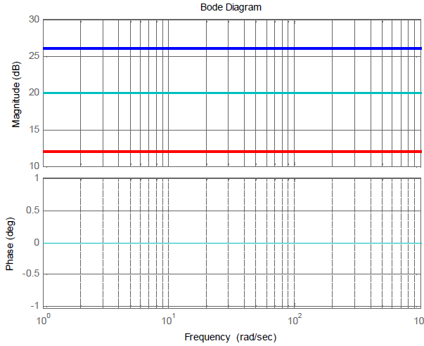
Example1 of Class-I: The Factor Constant Gain K
K = 20
K = 10
K = 4
K = 4, 10, and 20

Slide 10
Example2 of Class-I: when G(s)H(s) = 6 and -6
Bode Plot for G(jω)H(jω) = 6
20log|G(jω)H(jω)|
$∠$G(jω)H(jω)
Magnitude (dB)
Phase (degree)
15.5
0º
Frequency (rad/sec)
ω
0
Frequency (rad/sec)
ω
Bode Plot for G(jω)H(jω) = -6
20log|G(jω)H(jω)|
$∠$G(jω)H(jω)
Magnitude (dB)
Phase (degree)
15.5
0º
ω
-180º
0
Frequency (rad/sec)
ω
Frequency (rad/sec)

Slide 11
Corner Frequency or Break Point
The low frequency asymptote ($ω≪\frac{1}{T}$) and high frequency asymptote ($ω≫\frac{1}{T}$) are intercept at 0 dB line when ωT=1 or$ω=\frac{1}{T}$ , that is the frequency of interception and is called as corner frequency or break point or break frequency.

Slide 12
Class-II: The Integral Factor ${(jω)}^{−1}$
If the open loop gain $G\left(jω\right)H\left(jω\right)={(jω)}^{−1} = \frac{1}{jω}$ , $it means a pole is exist at the orign.$
Magnitude (dB) ${\left|G\left(jω\right)H\left(jω\right)\right|}_{dB}=20log\left|\frac{1}{jω}\right|=20\log\left(1\right)−20\log\left(ω\right)=−20log⁡(ω)$
When the above equation is plotted against the frequency logarithmic, the magnitude plot produced is a straight line with a negative slope of 20 dB/ decade.
Phase $∠G\left(jω\right)H\left(jω\right)=∠\frac{1}{jω}=−{90}^{o}$
When the above equation is plotted against the frequency logarithmic, the phase plot produced is a straight line at -90°.
Corner frequency or break point ω = 1 at the magnitude of 0 dB.

Slide 13
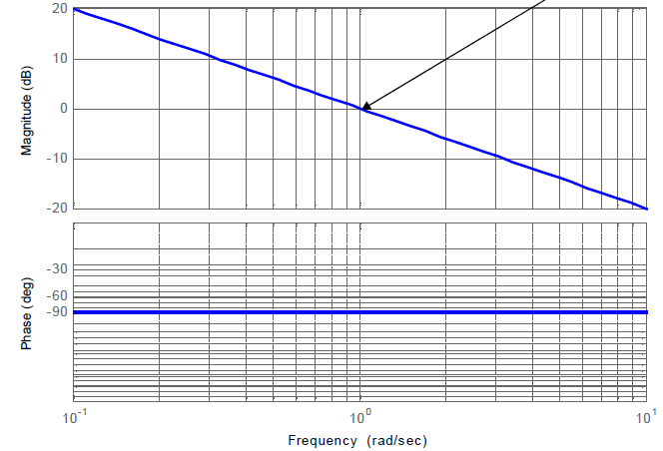
Example1 of Class-II: The Factor ${(jω)}^{−1}$
The slope intersects with 0 dB line at frequency ω =1
A slope of 20 dB/dec
for magnitude plot of factor $\frac{1}{jω}$
A straight horizontal line at 90° for phase plot of factor $\frac{1}{jω}$

Slide 14
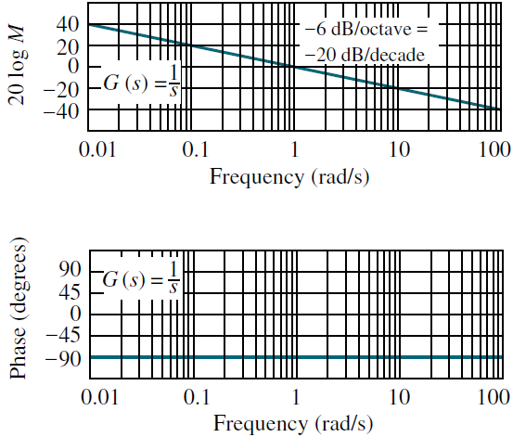
Example2 of Class-II: The Factor ${(jω)}^{−1}$
The frequency response of the function G(s) = 1/s, is shown in the Figure.
The Bode magnitude plot is a straight line with a -20 dB/decade slope passing through zero dB at ω = 1.
The Bode phase plot is equal to a constant -90º.

Slide 15
Class-II: The Derivative Factor $jω$
If the open loop gain $G\left(jω\right)H\left(jω\right)=$ $jω, it means a zero is exist at the orign.$
Magnitude (dB) ${\left|G\left(jω\right)H\left(jω\right)\right|}_{dB}=20log\left|jω\right|=20\log\left(ω\right)$
When the above equation is plotted against the frequency logarithmic, the magnitude plot produced is a straight line with a positive slope of 20 dB/ decade.
Phase $∠G\left(jω\right)H\left(jω\right)=∠jω={90}^{o}$
When the above equation is plotted against the frequency logarithmic, the phase plot produced is a straight line at 90°.
Corner frequency or break point ω = 1 at the magnitude of 0 dB.

Slide 16
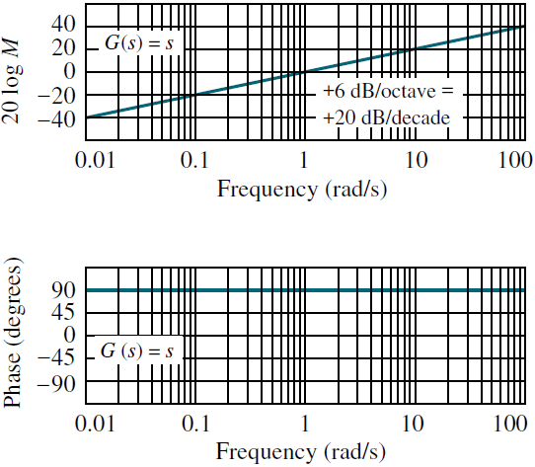
Example of Class-II: The Factor Jω
The frequency response of the function G(s) = s, is shown in the Figure.
G(s) = s has only a high-frequency asymptote, where s = jω.
The Bode magnitude plot is a straight line with a +20 dB/decade slope passing through 0 dB at ω = 1.
The Bode phase plot is equal to a constant +90º.

Slide 17
Class-II (Generalize form): The Factor ${(jω)}^{±P}$
Generally, for a factor ${(jω)}^{±P}$
Magnitude (dB) ${\left|G\left(jω\right)H\left(jω\right)\right|}_{dB}=±P(20 dB/dec)$
Phase $∠G\left(jω\right)H\left(jω\right)=∠\frac{1}{jω}=±P{(90}^{o})$
Corner frequency or break point ω = 1 at the magnitude of 0 dB.
In decibels the slopes are ±P × 20 dB per decade or ±P × 6 dB per octave (an octave is a change in frequency by a factor of 2).
For Example the magnitude and phase plot for factor ${(jω)}^{2}$
Magnitude (dB) ${\left|G\left(jω\right)H\left(jω\right)\right|}_{dB}=2(20 dB/dec)$= $40 dB/dec$
Phase $∠G\left(jω\right)H\left(jω\right)=$ 2(90º) = 180º

Slide 18
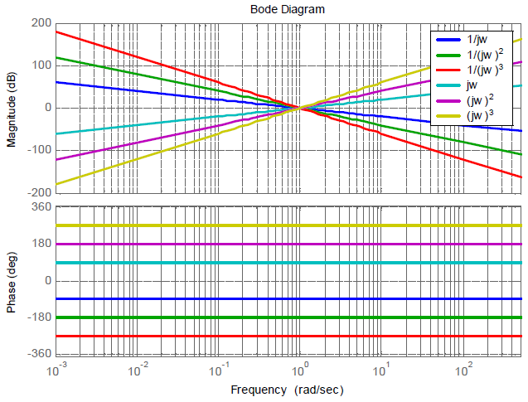
Example1 of Class-II (Generalize): The Factor ${(jω)}^{±P}$

Slide 19
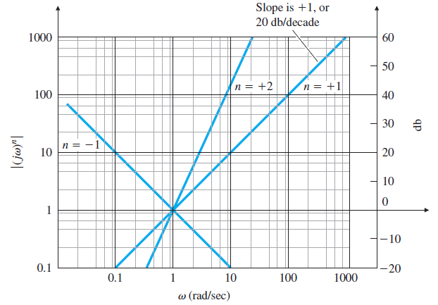
Example2 of Class-II (Generalize): The Factor ${(jω)}^{±P}$

Slide 20
Class-III: First Order Factors, ${(1+ jω)}^{−1}$
If the open loop gain $G\left(jω\right)H\left(jω\right)={(1+jωT)}^{−1} = \frac{1}{1+jωT}$ , where T is a real constant.
Magnitude (dB) ${\left|G\left(jω\right)H\left(jω\right)\right|}_{dB}=20log\left|\frac{1}{1+jωT}\right|=20\log\left|1\right|−20\log\left|1+jωT\right|=−20log⁡\sqrt{1^{2}+ω^{2}T^{2}}$
When $ω≪\frac{1}{T}$ , then magnitude ${\left|G\left(jω\right)H\left(jω\right)\right|}_{dB}=$ $20\log\left(1\right)=0$ dB,
The magnitude plot is a horizontal straight line at 0 dB at low frequency (ωT << 1).
When $ω≫\frac{1}{T}$ , then magnitude ${\left|G\left(jω\right)H\left(jω\right)\right|}_{dB}=$ $−20\log\left(ωT\right)$
The magnitude plot is a straight line with a slope of -20 dB/decade at high frequency (ωT >> 1).
Low-Frequency Asymptote (letting frequency s 0)
High-Frequency Asymptote (letting frequency s ∞)

Slide 21
Class-III: First Order Factors, ${(1+ jω)}^{−1}$
The low frequency asymptote ($ω≪\frac{1}{T}$) and high frequency asymptote ($ω≫\frac{1}{T}$) are intercept at 0 dB line when ωT=1 or$ω=\frac{1}{T}$ , that is the frequency of interception and is called as corner frequency or break point or break frequency.
At corner frequency, the maximum error between the plot obtained through asymptotic approximation and the actual plot is 3 dB.
Phase $∠G\left(jω\right)H\left(jω\right)=∠\frac{1}{1+jωT}=−\tan^{−1}{ωT}$
When $ω≪\frac{0.1}{T}$ , then phase$∠G\left(jω\right)H\left(jω\right)={ 0}^{o}$
(So it’s a horizontal straight line at 0º until ω=0.1/T)
When $ω=\frac{1}{T}$ , then phase$∠G\left(jω\right)H\left(jω\right)={ −45}^{o}$
(it’s a horizontal straight line with a slope of -45º/decade until ω=10/T)
When $ω≫\frac{10}{T}$ , then phase$∠G\left(jω\right)H\left(jω\right)={ −90}^{o}$
(So it’s a horizontal straight line at -90º)

Slide 22
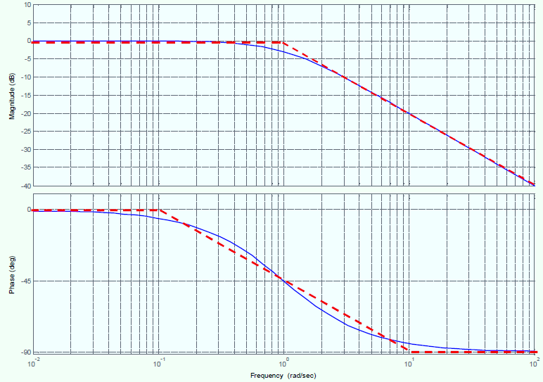
Example1 of Class-III: First Order Factors, ${(1+ jω)}^{−1}$
Bode Diagram for Factor (1+jω)⁻¹

Slide 23
Example2 of Class-III: The Factor ${(a+jω)}^{−1}$
Problem: find the Bode plots for the transfer function G(s) = 1/(s + a), where s = jω, and a is the constant which representing the break point or corner frequency.
Low-Frequency Asymptote (letting frequency s 0)
When $ω≪\frac{1}{a}$ , then the magnitude ${\left|G\left(jω\right)\right|}_{dB}$ = $20log\left|\frac{1}{a}\right|$
The Bode plot is constant until the break frequency, a rad/s, is reached.
When $ω≪\frac{1}{a}$, then the phase$∠G\left(jω\right)={ 0}^{o}$

Slide 24
Example2 of Class-III: The Factor ${(a+jω)}^{−1}$
Continue:
High-Frequency Asymptote (letting frequency s ∞)
When $ω≫\frac{1}{a}$ , then the magnitude ${\left|G\left(jω\right)H\left(jω\right)\right|}_{dB}=$ $20log\left|\frac{1}{a\left(\frac{s}{a}\right)}\right|$
Magnitude (dB):
Phase(degree):
When $ω=\frac{1}{a}$, then the phase$∠G\left(jω\right)={ −45}^{o}$

Slide 25
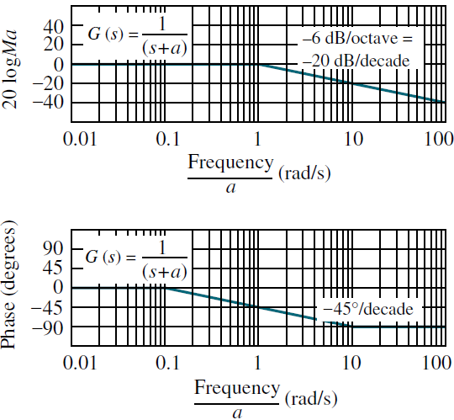
Example2 of Class-III: First Order Factors, ${( a+jω)}^{−1}$
The normalized Bode of the function G(s) = 1/(s+a), is shown in the Figure.
where s = jω and a is break point or corner frequency.
The high-frequency approximation equals the low frequency approximation when ω = a, and decreases for ω > a.
The Bode log magnitude diagram will decrease at a rate of 20 dB/decade after the break frequency.
The phase plot begins at 0º and reaches -90º at high frequencies, going through -45º at the break frequency.

Slide 26
Class-III: First Order Factors, $(1+ jω)$
If the open loop gain $G\left(jω\right)H\left(jω\right)=(1+jωT)$, where T is the real constant.
Then its Magnitude (dB) ${\left|G\left(jω\right)H\left(jω\right)\right|}_{dB}=20log\left|1+jωT\right|=20log⁡\sqrt{1^{2}+ω^{2}T^{2}}$
When $ω≪\frac{1}{T}$ , then magnitude ${\left|G\left(jω\right)H\left(jω\right)\right|}_{dB}=$ $20\log\left(1\right)=0$ dB,
The magnitude plot is a horizontal straight line at 0 dB at low frequency (ωT << 1).
When $ω≫\frac{1}{T}$ , then magnitude ${\left|G\left(jω\right)H\left(jω\right)\right|}_{dB}=$ $20\log\left(ωT\right)$
The magnitude plot is a straight line with a slope of 20 dB/decade at high frequency (ωT >> 1).
Low-Frequency Asymptote (letting frequency s 0)
High-Frequency Asymptote (letting frequency s ∞)

Slide 27
Class-III: First Order Factors, $(1+ jω)$
The Phase will be$∠G\left(jω\right)H\left(jω\right)=∠1+jωT=\tan^{−1}{ωT}$
When $ω≪\frac{0.1}{T}$ , then phase$∠G\left(jω\right)H\left(jω\right)={ 0}^{o}$
(So it’s a horizontal straight line at 0º until ω=0.1/T)
When $ω≫\frac{10}{T}$ , then phase$∠G\left(jω\right)H\left(jω\right)={ 90}^{o}$
(it’s a horizontal straight line with a slope of 45º/decade until ω=10/T)
When $ω=\frac{1}{T}$ , then phase$∠G\left(jω\right)H\left(jω\right)={ 45}^{o}$
(So it’s a horizontal straight line at 90º)

Slide 28
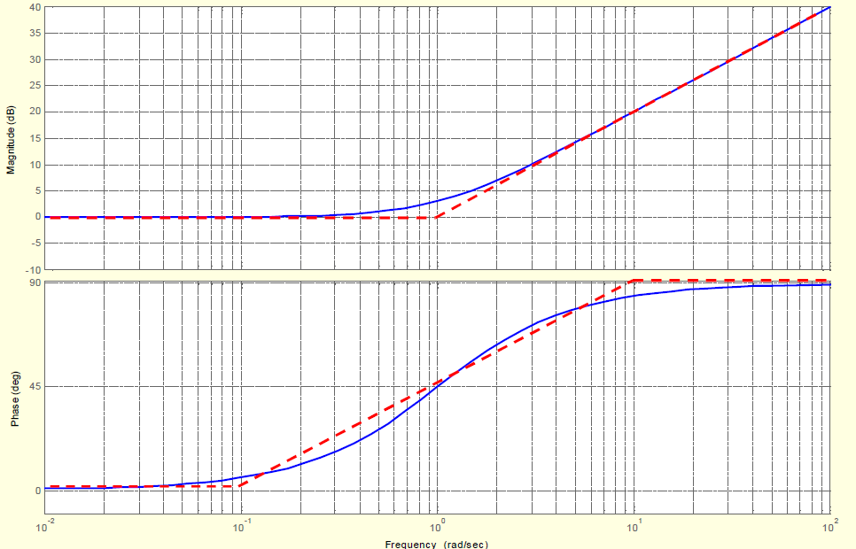
Example3 of Class-III: First Order Factors, $(1+ jω)$

Slide 29
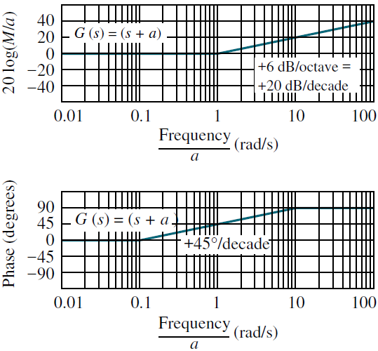
Example4 of Class-III: First Order Factors, $(1+ jω)$
The normalized Bode of the function G(s) = (s + a), is shown in the Figure.
where s = jω and a is break point or corner frequency.
The high-frequency approximation equals the low frequency approximation when ω = a, and increases for ω > a.
The Bode log magnitude diagram will increases at a rate of 20 dB/decade after the break frequency.
The phase plot begins at 0º and reaches +90º at high frequencies, going through +45º at the break frequency.

Slide 30
Example-5: Obtain the Bode plot of the system given by the transfer function;
We convert the transfer function in the following format by substituting s = jω
We call ω = 1/2 , the break point or corner frequency. So for
So when ω << 1 , (i.e., for small values of ω), then G( jω ) ≈ 1
Therefore taking the log magnitude of the transfer function for very small values of ω, we get
Hence below the break point, the magnitude curve is approximately a constant.
So when ω >> 1, (i.e., for very large values of ω), then
(1)

Slide 31
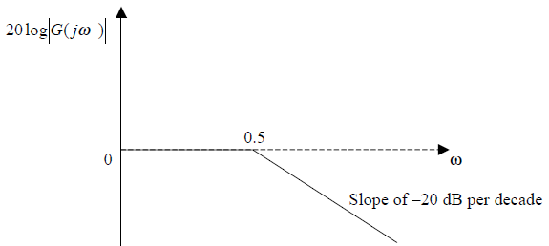
Example-5: Continue.
Similarly taking the log magnitude of the transfer function for very large values of ω, we have;
So we see that, above the break point the magnitude curve is linear in nature with a slope of –20 dB per decade.
The two asymptotes meet at the break point.
The asymptotic bode magnitude plot is shown below.

Slide 32
Example-5: Continue.
The phase of the transfer function given by equation (1) is given by;
So for small values of ω, (i.e., ω ≈ 0), we get φ ≈ 0.
For very large values of ω, (i.e., ω →∞), the phase tends to –90º degrees.
To obtain the actual curve, the magnitude is calculated at the break points and joining them with a smooth curve. The Bode plot of the above transfer function is obtained using MATLAB by following the sequence of command given.
num = 1;
den = [2 1];
sys = tf(num,den);
grid;
bode(sys)

Slide 33
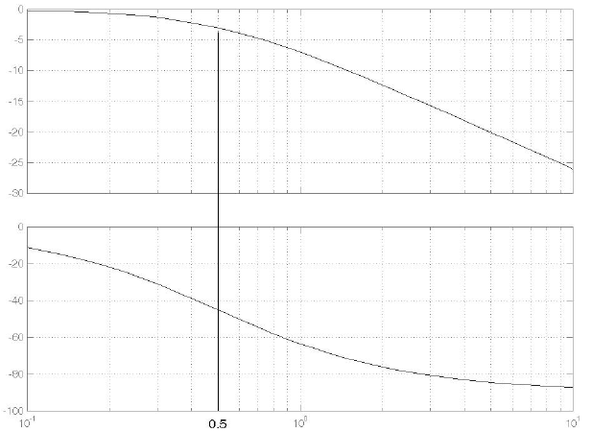
Example-5: Continue.
The plot given below shows the actual curve.

