Slide 1
Biomedical Control Systems (BCS)
Module Leader: Dr Muhammad Arif
Email: muhammadarif13@hotmail.com
Please include “BCS-10BM" in the subject line in all email communications to avoid auto-deleting or junk-filtering.
Batch: 10 BM
Year: 3rd
Term: 2nd
Credit Hours (Theory): 4
Lecture Timings: Monday (12:00-2:00) and Wednesday (8:00-10:00)
Starting Date: 16 July 2012
Office Hour: BM Instrumentation Lab on Tuesday and Thursday (12:00 – 2:00)
Office Phone Ext: 7016

Slide 2
The Root Locus Method

Slide 3
Objectives
The definition of a root locus
How to sketch a root locus
How to refine the sketch of a root locus
How to use the root locus to find the poles of a closed-loop system

Slide 4
Root Locus (Evans, 1948; 1950)
Closed-loop system response depends on the location of closed loop poles.
If system has a variable design parameter (e.g., a simple gain adjustment ), then the closed-loop pole locations depend on the value of the design parameter.
Root Locus is an analytical method which shows graphically the location of poles of the closed-loop transfer function as a function of the design parameter (e.g., gain factor, K) of the open-loop transfer function.
The root locus is the path of the roots of the characteristic equation traced out in the s-plane as a system parameter varies from zero to infinity.

Slide 5
Root Locus Technique
Root Locus technique permit accurate computation of the time-domain response in addition to yielding readily available frequency response information.
Root locus is a powerful method of analysis and design for stability and transient response.
The Root Locus gives a graphical representation of a system’s stability. We can clearly see ranges of stability, ranges of instability, and the conditions that cause a system to break into oscillation.
The root locus can be used to describe qualitatively the performance of a system as various parameters are changed.

Slide 6
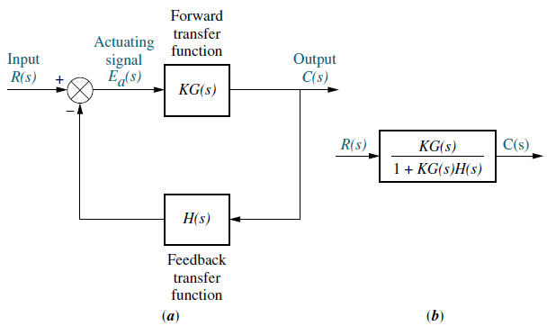
A Block Diagram of Typical Closed-Loop Feedback Control System
FIGURE-1
Closed-loop system;
b. equivalent closed-loop transfer function.
Where,
K is the open-loop gain factor.
G(s) is the forward-path transfer function.
H(s) is the feedback-path transfer function.
The open-loop transfer function of the system is KG(s)H(s).
The closed-loop transfer function of the system is
The closed-loop poles are roots of the characteristic equation, 1 + KG(s)H(s).

Slide 7
Letting, , and ;
Where N and D are factored polynomials in the complex variable s and signify numerator, N, and denominator, D, terms, respectively.
The open-loop transfer function, KG(s)H(s), can be represented by;
KG(s)H(s) = $\frac{\text{K}\text{N}\text{G}\text{(}\text{s}\text{)}\text{N}\text{H}\text{(}\text{s}\text{)}}{\text{D}\text{G}\text{(}\text{s}\text{)}\text{D}\text{H}\text{(}\text{s}\text{)}}$
The closed-loop transfer function, T(s) = , can be represented by;
(a)
(b)

Slide 8
In general, the location of the closed-loop poles changes as the open-loop gain factor K is varied.
A locus of these poles plotted in the s-plane as a function of K is called Root-Locus.
For K = 0, the poles of the closed-loop transfer function of equation (b) are equal to the poles of the open-loop transfer function of equation (a).
For K ~∞, the poles of the closed-loop transfer function of equation (b) are equal to the zeros of the open-loop transfer function of equation (a).
Thus as K increase from zero to infinity, the loci of the close-loop poles originate from the open-loop poles and terminate at the open-loop zeros.

Slide 9
Open vs. Close Loop Poles
We can determine the poles of open-loop transfer function KG(s)H(s), since these poles arise from simple cascaded first-order or second-order subsystems. Further, variations in system gain factor K do not affect the location of any pole of the open-loop transfer function.
On the other hand, we cannot determine the poles of closed-loop transfer function T(s) = KG(s)/[1 + KG(s)H(s)] unless we factor the denominator. Also, the poles of closed-loop transfer function T(s) change with system gain K.

Slide 10
Root-Locus Plot Basics
The number of poles of the control system are equal to the number of zeros.
If the zeros are not present in the open-loop transfer function then it will be also absent in the root-locus plot.
If the number of zeros in the open loop transfer function are less than the number of poles in the open-loop transfer function then the remaining zeros are exist at the infinity.
For root-locus plot, the first step is to always place the zeros and poles of the open-loop transfer function in the s-plane (for continuous system) or z-plane (for discrete system).
The root-locus always starts from the pole of the open-loop transfer function at K = 0 and finish at the zeros of the open-loop transfer function.

Slide 11
Example-1:
The poles of open-loop transfer function KG(s)H(s) are 0; -2; and -4.
The zeros of open-loop transfer function KG(s)H(s) are -1 and -3.
The closed-loop TF is
The zeros of closed-loop TF, T(s), consist of the zeros of G(s) and the poles of H(s).
The poles of closed-loop TF, T(s), are not immediately known without factoring the denominator, and they are a function of system gain factor K.
Since the system’s transient response and stability are dependent upon the poles of closed-loop transfer function, T(s), we have no knowledge of the system’s performance unless we factor the denominator (characteristic equation) for specific values of K.
The root locus will be used to give us a vivid picture of the poles of closed-loop transfer function, T(s), as K varies.

Slide 12
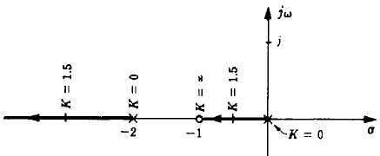
Example-2: Consider the open-loop transfer function below and construct the root-locus by factoring the denominator polynomial of the closed-loop transfer function.
For H = 1, the unity-feedback closed-loop transfer function is;
The close-loop roots (or poles) of the system are easily determined by factoring the denominator polynomial;
The locus of these roots (or poles) plotted as a function of K is shown in Fig.(a).
This root-locus has Two branches.
First branch is from open loop pole at the origin to open-loop zero at -1.
Second branch is from the open-loop pole at -2 to the open-loop zero at - ∞.
Root-Locus Plot
Fig.(a)

Slide 13
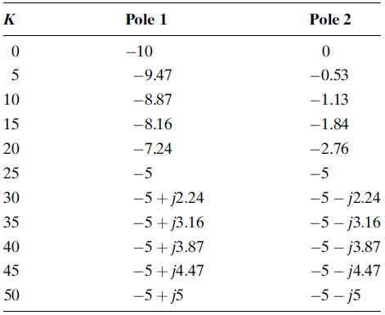
Block Diagram Representation of a Tracking System
(a)
(b)
FIGURE:
Block diagram of security cameras with auto tracking system;
Closed-loop transfer function.
TABLE: Pole location as function of gain factor K for the system.

Slide 14
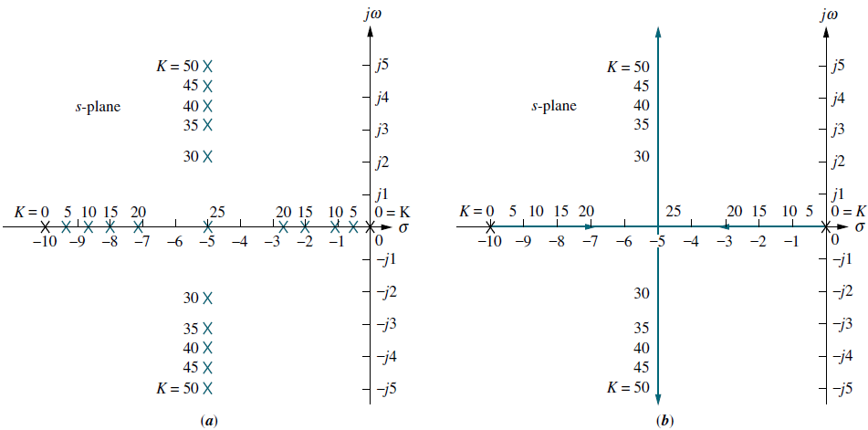
Closed-loop poles change location as gain K is varied
Pole Plot
Root Locus
FIGURE: a) Pole plot; b) Root locus.

Slide 15
Properties of the Root Locus
One method to plot the root locus require factoring the polynomial in the denominator of the transfer function.
Without a computer, factoring the polynomial would be quite a problem for numerous values of gain.
However using the properties of the root locus, it is possible to make a rapid sketch of the root locus for higher-order systems without having to factor the denominator of the closed-loop transfer function.
The properties of the root locus can be derived from the general control system of Figure-1.

Slide 16
Magnitude and Angle Criterion
The closed-loop transfer function for the system is;
The characteristic equation of the closed-loop system is;
1 + KG(s)H(s) = 0 or KG(s)H(s) = -1
where -1 is represented in polar form as
Equation (i) can be written as,
(i)

Slide 17
Magnitude and Angle Criterion
A value of s is a closed-loop pole if;
Magnitude Criterion
(ii)
Angle Criterion
(iii)
If the angle of the complex number is an odd multiple of 180º, that value of s is a system pole for some particular value of K.
Finally, if point s is a closed-loop system pole for some value of gain, K, then that value of gain, K, can be found by dividing the product of the pole lengths by the product of the zero lengths.
(iv)

Slide 18
Complex Numbers
Rectangular Form = x + jy
Polar Form = r$∠θ$
Euler Form = $e^{jθ}$= $\cos{θ}+j\sin{θ}$
Rectangular to Polar Conversion
r = $\sqrt{x^{2}+y^{2}}$
θ = $\tan^{−1}{\frac{y}{x}}$
Polar to Rectangular Conversion
x = rcosθ
y = rsinθ

Slide 19
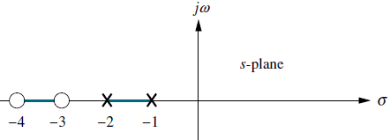
Example-3: Check whether point s = - 2 + j3 is a closed-loop system pole for some value of gain, K, or not.
Closed-Loop System
Root-Locus Plot
For this system, the open-loop transfer function is
The closed-loop transfer function is
If point s is a closed-loop system pole for some value of gain, K, then s must satisfy Eqs. (ii) and (iii).

Slide 20
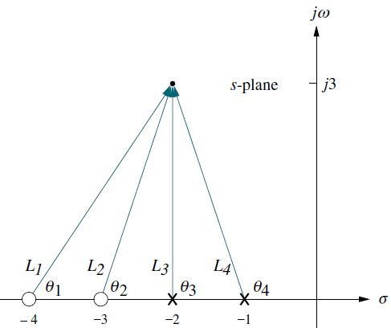
Example-3: Continue.
Consider the point s = - 2 +j3. If this point is a closed-loop pole for some value of gain, then the angles of the zeros minus the angles of the poles must equal an odd multiple of 180º.
L1 = (-2 + j3) – (-4 + j0) = 2 + j3 = $\sqrt{13}<56.3o$
L2 = (-2 + j3) – (-3 + j0) = 1 + j3 = $\sqrt{10}<71.5o$
L3 = (-2 + j3) – (-2 + j0) = 0 + j3 = 3 $<90o$
L4 = (-2 + j3) – (-1 + j0) = -1 + j3 = $\sqrt{10}<108.4o$
Hence,
Vector representation of G(s) at -2 + j3
Therefore, s = -2 + j3 is NOT a point on the root locus, or alternatively, s = -2 + j3 is NOT a closed-loop pole for any value of gain K.

Slide 21
Example-3: Continue.
If these calculations are repeated for another point s = - 2 + j($\sqrt{2}/2$). If this point is a closed-loop pole for some value of gain K, then the angles of the zeros minus the angles of the poles must equal an odd multiple of 180º.
L1 = (- 2 + j($\sqrt{2}/2$)) – (–4 + j0) = 2 + j($\sqrt{2}/2$) = 2.12 $<19.4o$
L2 = (- 2 + j($\sqrt{2}/2$))– (–3 + j0) = 1 + j($\sqrt{2}/2$)= 1.22 $<35.3o$
L3 = (- 2 + j($\sqrt{2}/2$))– (–2 + j0) = 0 + j($\sqrt{2}/2$)= $\frac{\sqrt{2}}{2}<90o$
L4 = (- 2 + j($\sqrt{2}/2$))– (–1 + j0) = -1 + j($\sqrt{2}/2$)= 1.22 $<144.7o$
Hence, θ1 + θ2 – θ3 – θ4 = 19.4º + 35.3º – 90º – 144.7^{o+}= -180º
So, angles do add up to 180º, therefore s = - 2 + j($\sqrt{2}/2$) is a point on the root locus, or alternatively, s = - 2 + j($\sqrt{2}/2$) is a closed-loop pole for some value of gain K.
The value of gain K is calculated using Eq. (iv) as;
Thus, the point s = - 2 + j($\sqrt{2}/2$) is a point on the root locus for a gain K=0.33.

Slide 22
Sketching the Root Locus
The following FIVE rules allow us to sketch the root locus using minimal calculations.
Number of Branches: The number of branches of the root locus equals the number of closed-loop poles.
Symmetry: The root locus is symmetrical about the real axis.
Real-Axis Segments: On the real axis, for K > 0 the root-locus exists to the left of an odd number of real-axis finite open-loop poles and/or finite open-loop zeros.
Starting and Ending Points: The root locus begins at the finite and infinite poles of open-loop transfer function, G(s)H(s), and ends at the finite and infinite zeros of open-loop transfer function, G(s)H(s).
Behavior at Infinity: The root locus approaches straight lines as asymptotes as the locus approaches infinity. Further, the equation of the asymptotes is given by the real-axis intercept, σ_{a} and angle, θ_{a} as follows:
(v)
(vi)

Slide 23
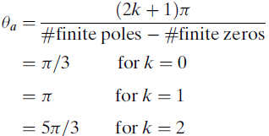
Sketching a Root Locus with Asymptotes
Example-4: Sketch the root locus for the system.
Let us begin by calculating the asymptotes.
Using Eq. (v), the real-axis intercept is evaluated as;
The angles of the lines that intersect at - 4/3, given by Eq. (vi), are
$$=\frac{(2k+1)π}{4 −1}$$
Number of finite poles = n = 4
Number of finite zeros = m = 1
Number of asymptotes = n - m = 3
Number of branches or loci equals to the number of finite poles (n) = 4
If the value for, k, continued to increase, the angles would begin to repeat.
The number of lines obtained equals the difference between the number of finite poles and the number of finite zeros.

Slide 24
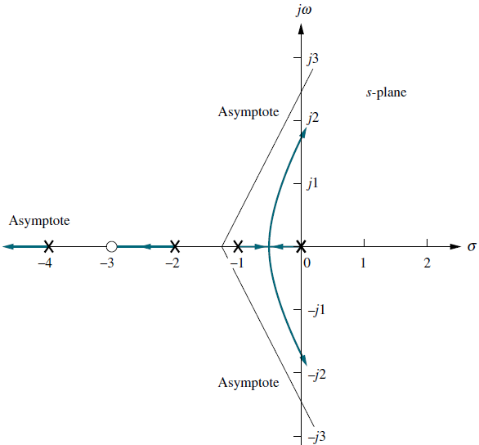
Example-4: Continue.
Root-Locus Plot
This Figure shows the complete root locus as well as the asymptotes that were just calculated.
Notice that we have made use of all the rules learned so far.
For this example there are more open-loop poles than open-loop zeros. Thus, there must be zeros at infinity.
The asymptotes tell us how we get to these zeros at infinity.
The real-axis segments lie to the left of an odd number of poles and/or zeros.
The locus starts at the open-loop poles and ends at the open-loop zeros.
For this example there is only one open-loop finite zero and three infinite zeros.
Rule 5, then, tells us that the three zeros at infinity are at the ends of the asymptotes.

Slide 25
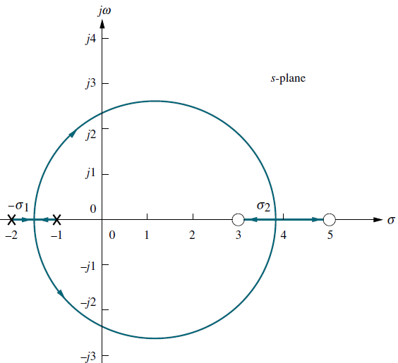
Real-Axis Breakaway and Break-In Points
Numerous root loci appear to break away from the real axis as the system poles move from the real axis to the complex plane.
The breakaway point occurs at a point of maximum gain on the real axis between the open-loop poles.
At other times the loci appear to return to the real axis as a pair of complex poles becomes real.
The gain at the break-in point is the minimum gain found along the real axis between the two zeros.
The figure shows a root locus leaving the real axis between -1 and -2 and returning to the real axis between +3 and +5.
The point where the locus leaves the real axis, σ₁, is called the breakaway point.
The point where the locus returns to the real axis, σ₂, is called the break-in point.
Figure: shows real-axis breakaway (σ₁) and break-in points (σ₂)

Slide 26
Methods to find Break-away and Break-in Points in the Root-Locus.
There are THREE methods for finding the points at which the root locus breaks away from and breaks into the real axis.
Breakaway and Break-in Points via Differentiation.
Breakaway and Break-in Points Without Differentiation.
The root locus program in Matlab.

Slide 27
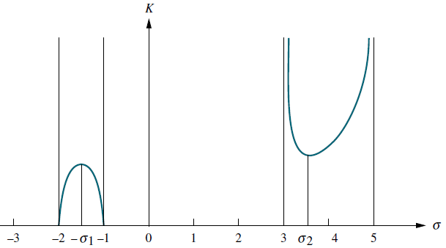
Breakaway and Break-in Points via Differentiation
The first method is to maximize and minimize the gain, K, using differential calculus. For all points on the root locus.
We know that gain factor K is equal to,
For points along the real-axis segment of the root locus where break-away and break-in points could exist, s = σ. Hence,
Figure: Variation of gain along the real axis for the root locus.
(viii)
This equation represents a curve of K versus σ as shown in the above Figure.
Hence, if we differentiate Eq. (viii) with respect to σ and set the derivative equal to zero, we can find the points of maximum and minimum gain K and hence the break-away and break-in points.

Slide 28
Example-5: Find the breakaway and break-in points for the root locus of Figure, using differential calculus.
Using the open-loop poles and zeros, we represent the open-loop system whose root locus is shown in Figure as follows:
But for all points along the root locus, KG(s)H(s) = -1, and along the real axis, s = σ. Hence,
Figure: shows real-axis breakaway (σ₁) and break-in points (σ₂)
or
Differentiating K with respect to σ and setting the derivative equal to zero yields;
$\frac{dK}{dσ}$ = $\frac{− [ \left(σ^{2} − 8σ + 15\right)\left(2σ+3\right) −\left(σ^{2}+3σ + 2\right)\left(2σ −8\right)]}{\left(σ^{2} − 8σ + 15\right)2}$ = 0
=>
$\frac{dK}{dσ}$ = $\frac{ \left({11σ}^{2} −26σ − 61\right)}{\left(σ^{2} − 8σ + 15\right)2}$ = 0
$${11σ}^{2} −26σ − 61=0$$
Hence, solving for σ, we find the
break-away and break-in points;
σ = -1.45 and 3.82

Slide 29
Breakaway and Break-in Points Without Differentiation
The second method is a variation on the differential calculus method. Called the transition method, it eliminates the step of differentiation (Franklin, 1991).
Breakaway and break-in points satisfy the relationship;
where z_{i} and p_{i} are the negative of the zero and pole values, respectively, of G(s)H(s).
Solving Eq. (vii) for σ, the real-axis values that minimize or maximize K, yields the break-away and break-in points without differentiating.
(vii)

Slide 30
Example-6: Repeat example-5 without differentiating.
Using Eq.(vii),
(vii)
=>
$$\frac{\left(σ −5\right)+(σ −3)}{(σ −3)(σ −5)}= \frac{\left(σ +2\right)+(σ +1)}{(σ +1)(σ +2)}$$
=>
$$\left(2σ −8\right)\left(σ +1\right)\left(σ +2\right)=\left(2σ +3\right)(σ −3)(σ −5)$$
=>
2$σ3+6σ2+4σ−8σ2−24σ−16=2σ3−16σ2+30σ+3σ2−24σ+45$
=>
$$11σ2 −26σ−61=0$$
=>
σ = -1.45 and 3.82

Slide 31
Example-7: Determine the break-away points for the system without differentiating.
$$G\left(s\right)H\left(s\right)=\frac{K}{s(s+1)(s+2)}$$
$$\frac{1}{σ}+\frac{1}{σ+1}+\frac{1}{σ+2}=0$$
=>
$$\left(σ+1\right)\left(σ+2\right)+σ\left(σ+2\right)+σ\left(σ+1\right)=0$$
=>
$$3σ2+6σ+2=0$$
=>
$$σ=−0.423, −1.577$$
For K > 0, the branches of the root locus lie between 0 and -1, and between -∞ and -2.
Therefore, the root at -0.423 is a breakaway point of the system for K > 0.
For K < 0, the portion of the real axis between -1 and -2 is on the root locus.
Therefore, the root at -1.577 is a breakaway point of the system for K < 0.

Slide 32
Example-8: Sketch the root locus for the system with the open loop transfer function is;
Number of finite poles = n = 3.
Number of finite zeros = m = 0.
Number of asymptotes = n - m = 3.
Number of branches or loci equals to the number of finite poles (n) = 3.
The portion of the real-axis between, 0 and -2, and between, -4 and -∞, lie on the root locus for K > 0.
Using Eq. (v), the real-axis asymptotes intercept is evaluated as;
The angles of the lines that intersect at - 2, given by Eq. (vi), are;
$$σa =\frac{−2−4}{n −m} = \frac{−6}{3 −0} = −2$$
$$θa =\frac{(2k+1)π}{n −m} = \frac{(2k+1)π}{3}$$
For K = 0, θa = 60º
For K = 1, θa = 180º
For K = 2, θa = 300º

Slide 33
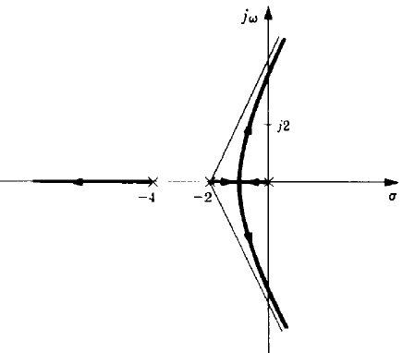
Example-8: Continue.
Since two branches of the root-locus for K > 0 come together on the real axis between 0 and -2, a breakaway point exists on that portion of the real axis.
The exact location of the breakaway point is determined as;
Where p_{i} and z_{i} are the poles and zeros of open loop transfer function GH.
In this example,
Using Eq. (vii), the breakaway point, σ, can be determine as;
Which simplifies to
The solution of the above equation is
(vii)
$$\frac{1}{σ}+\frac{1}{σ+2}+\frac{1}{σ+4}=0$$
σ
$$3σ2+12σ+8=0$$
$σ=−0.845,$ and -3.15.
Root-Locus Plot

Slide 34
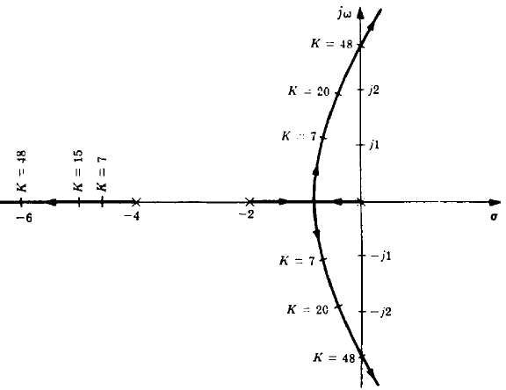
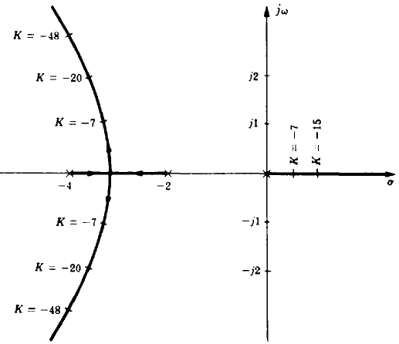
Example-8: Continue.
Root Locus for K > 0
Root Locus for K < 0
The root locus for K < 0 is constructed in a similar manner.
The portion of the real axis between 0 and ∞ and between -2 and -4 lie on the root locus.
For K < 0, the break-away point is located at -3.15.
The asymptotes have angles of 0º, 120º, and 240º.

Slide 35
Example-9: Sketch the root locus for the system with the characteristic equation of;
Number of finite poles = n = 4.
Number of finite zeros = m = 1.
Number of asymptotes = n - m = 3.
Number of branches or loci equals to the number of finite poles (n) = 4.
The portion of the real-axis between, 0 and -2, and between, -4 and -∞, lie on the root locus for K > 0.
Using Eq. (v), the real-axis asymptotes intercept is evaluated as;
The angles of the asymptotes that intersect at - 3, given by Eq. (vi), are;
$$σa =\frac{\left(−2\right)+2\left(−4\right)−(−1)}{n −m} = \frac{−10+1}{4 −1} = −3$$
$$θa =\frac{(2k+1)π}{n −m} = \frac{(2k+1)π}{4−1}$$
For K = 0, θa = 60º
For K = 1, θa = 180º
For K = 2, θa = 300º

Slide 36
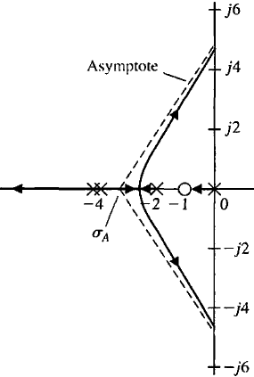
Example-9: Continue.
The root-locus plot of the system is shown in the figure below.
It is noted that there are three asymptotes. Since n – m = 3.
The root loci must begin at the poles; two loci (or branches) must leave the double pole at s = -4.
Using Eq. (vii), the breakaway point, σ, can be determine as;
The solution of the above equation is
$$σ=−2.59.$$

Slide 37
Example-10: Sketch the root loci for the system for K > 0.
The procedure for plotting the root loci is as follows:
Locate the open-loop poles and zeros on the complex plane. Root loci exist on the negative real axis between 0 and –1 and between –2 and –3.
The number of open-loop poles and that of finite zeros are the same. This means that there are no asymptotes in the complex region of the s plane.
Determine the breakaway and break-in points. The characteristic equation for the system is
(a)

Slide 38
Example-10: Continue.
The breakaway and break-in points are determined by taking the derivative of Eq. (a).
Notice that both points are on root loci. Therefore, they are actual breakaway or break-in points.
At point s = –0.634, the value of K is,
Similarly, at s = –2.366, the value of K is,

Slide 39
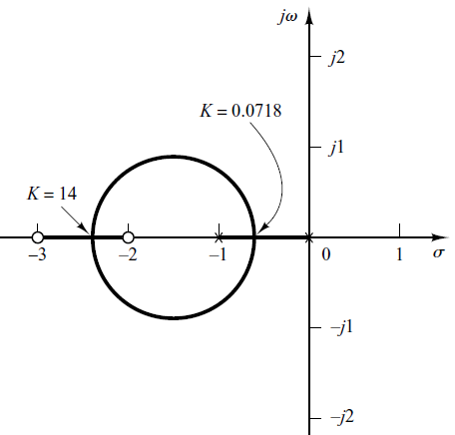
Example-10: Continue.
Note that point s = –0.634 lies between two poles, therefore it is a breakaway point, and point s = –2.366 lies between two zeros, hence it is a break-in point.
Determine a sufficient number of points that satisfy the angle condition. (It can be found that the root loci involve a circle with center at [ -2.366 – (-0.634) ]/2 = -0.866, -0.866 - 0.634 = –1.5 that passes through the breakaway and break-in points.)
The root-locus plot for this system is shown in the Figure.

Slide 40
Example-11: Sketch the root loci for the system.
A root locus exists on the real axis between points s = –1 and s = –3.6.
The intersection of the asymptotes and the real axis is determined as,
The angles of the asymptotes that intersect at – 1.3, given by Eq. (vi), are;
Since the characteristic equation is
We have
$$σa =\frac{0+0+3.6−1}{n −m} = \frac{2.6}{3 −1} = −1.3$$
$$θa =\frac{(2k+1)π}{n −m} = \frac{(2k+1)π}{3−1}$$
For K = 0, θa = 90º
For K = 1, θa = -90º or 270º
(a)

Slide 41
Example-11: Continue.
The breakaway and break-in points are found from Eq. (a) as,
From which we get,
Point s = 0 corresponds to the actual breakaway point. But points are neither breakaway nor break-in points, because the corresponding gain values K become complex quantities.

Slide 42
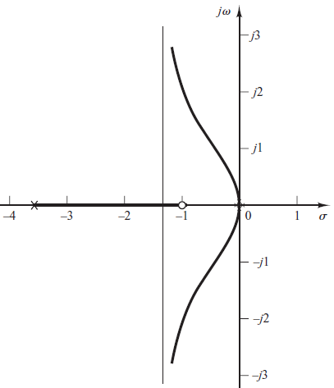
Example-11: Continue.
To check the points where root-locus branches may cross the imaginary axis, substitute $s=jω$ into the characteristic equation, yielding.
Notice that this equation can be satisfied only if $ω=0, K=0.$
Because of the presence of a double pole at the origin, the root locus is tangent to the $jω$ axis at $k=0$.
The root-locus branches do not cross the $jω$ axis.
The root loci of this system is shown in the Figure.

Slide 43
The jω-Axis Crossings
The jω-axis crossing is a point on the root locus that separates the stable operation of the system from the unstable operation.
The value of ω at the axis crossing yields the frequency of oscillation.
The gain K at the jω-axis crossing yields the maximum positive gain for system stability.
Above value of gain K at the jω-axis crossing , the closed-loop system’s poles move into the right half-plane, signifying that the system is unstable.
To find the jω-axis crossing, we can use the Routh-Hurwitz criterion as;
Forcing a row of zeros in the Routh table will yield the gain K;
Going back one row to the even polynomial equation (auxiliary equation) and solving for the roots yields the frequency at the imaginary-axis crossing.

Slide 44
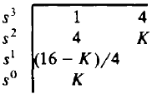
Example-12: Determine the frequency and the gain at the jω-axis crossover for the open-loop transfer function using a Routh table.
The characteristic equation for this system is;
The Routh table for the characteristic polynomial is;
The s¹ row is zero for K = 16. The auxiliary equation (from s² row) then becomes;
Thus for K = 16 the characteristic equation has solutions (closed-loop poles) at
s = ± j2, and the root-locus crosses the jw-axis at j2.

Slide 45
Example-13: For the system shown below, find the frequency and gain, K, for which the root locus crosses the imaginary jω-axis. For what range of gain K is the system stable?
The closed-loop transfer function for the system is;
Using the denominator and simplifying some of the entries by multiplying any row by a constant, we obtain the Routh array shown in the Table;

Slide 46
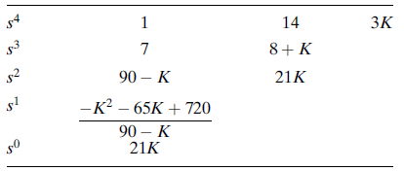
Example-13: Continue.
A complete row of zeros yields the possibility for imaginary axis roots.
For positive values of gain, K > 0, those for which the root locus is plotted, only the s¹ row can yield a row of zeros. Thus,
From the above equation, K is evaluated as; K = 9.65.
Forming the even polynomial by using the s² row with K = 9.65, we obtain
Where frequency s is found to be equal to ± j1.59.
Thus the root locus crosses the jω-axis at s = ± j1.59 at a gain, K = 9.65.
We conclude that the system is stable for 0 ≤ K < 9:65.

Slide 47
Practice Exercise-1
PROBLEM: Given a unity feedback system that has the forward transfer function;
Do the following:
Calculate the angle of G(s) at the point (3 + j0) by finding the algebraic sum of angles of the vectors drawn from the zeros and poles of G(s) to the given point.
Determine if the point specified in part (a) is on the root locus.
If the point specified in part (a) is on the root locus, then find the gain, K, using the lengths of the vectors.

Slide 48
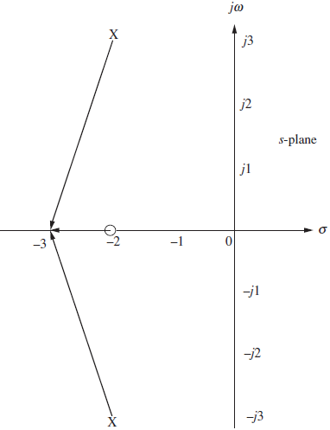
Answers of Practice Exercise-1

Slide 49
Practice Exercise-2
PROBLEM: Sketch the root locus and its asymptotes for a unity feedback system that has the forward transfer function

Slide 50
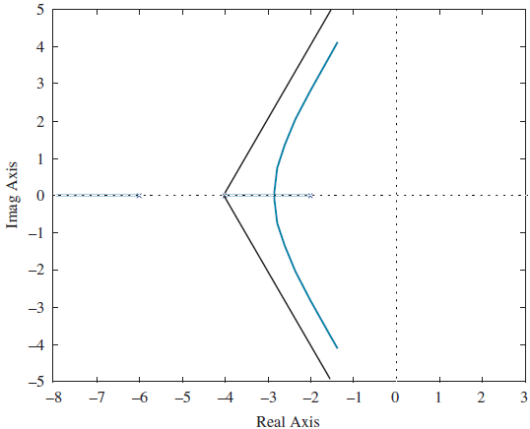
Answers of Practice Exercise-2

