Slide 1
Biomedical Control Systems (BCS)
Module Leader: Dr Muhammad Arif
Email: muhammadarif13@hotmail.com
Please include “BCS-10BM" in the subject line in all email communications to avoid auto-deleting or junk-filtering.
Batch: 10 BM
Year: 3rd
Term: 2nd
Credit Hours (Theory): 4
Lecture Timings: Monday (12:00-2:00) and Wednesday (8:00-10:00)
Starting Date: 16 July 2012
Office Hour: BM Instrumentation Lab on Tuesday and Thursday (12:00 – 2:00)
Office Phone Ext: 7016

Slide 2
Mathematical Modeling of Electrical Systems:

Slide 3
Kirchhoff’s Law:
Basic laws governing electrical circuits are Kirchhoff’s current law and voltage law.
Kirchhoff’s current law (node law) states that the algebraic sum of all currents entering and leaving a node is zero.
Kirchhoff’s voltage law (loop or mesh law) states that at any given instant the algebraic sum of the voltages around any loop in an electrical circuit is zero.
A mathematical model of an electrical circuit can be obtained by applying one or both of Kirchhoff’s laws to it.

Slide 4
Three Steps to get Transfer Function:
Apply Kirchhoff’s law (Node or Loop Law) and write the differential equations for the circuit.
Then take the Laplace transforms of the differential equations.
Finally solve for the transfer function.

Slide 5
Voltage, Current, Charge Relationship for Capacitor, Resistor, and Inductor.

Slide 6
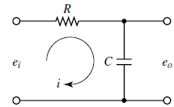
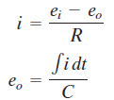
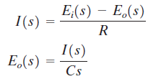
Example-1: Obtain the transfer function of the RC Circuit.
The equations of this RC circuits are;
The above Equations give a mathematical model of the RC circuit.
The Laplace transform of these equation are;

Slide 7
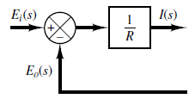
Block diagrams of these equations are;
Combining the above two blocks we get

Slide 8
The transfer function T of this unit feedback system or RC circuit is;
$$T=Eo(s)/Ei(s)=\frac{1/RCS}{1+1/RCS}$$
$$T=Eo(s)/Ei(s)=\frac{1}{RCS+1}$$

Slide 9
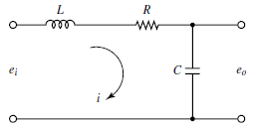
Example-2: Obtain the transfer function of the given RLC Circuit.
Applying Kirchhoff’s voltage law to the system, we obtain the following equations:
(a)
(b)
A transfer-function model of the circuit can be obtained by taking the Laplace transforms of Equations (a) and (b) with the assumption of zero initial condition, we obtain
(c)
(d)

Slide 10
The transfer function, T = E_{o}(s)/E_{i}(s), of this RLC circuit can be obtain as;
Taking the I(s) common in equation (c), will get equation (e),
Divide equation (d) by (e),
Finally, Multiply and divided by CS.
Hence, the transfer function, T = E_{o}(s)/E_{i}(s), of the RLC circuit after simplification is

Slide 11
Voltage Divider Rule:
Consider the series circuit shown below. Assume that the voltages e_{i} and e_{o} are the input and output of the circuit, respectively.
Then the transfer function of this circuit is

Slide 12
Complex Impedance Approach to get Transfer Function:
In deriving transfer functions for electrical circuits, it is convenient to write the Laplace-transformed equations directly, without writing the differential equations.
Remember that the impedance approach is valid only if the initial conditions involved are all zeros.
Since the transfer function requires zero initial conditions, the impedance approach can be applied to obtain the transfer function of the electrical circuit.
This approach greatly simplifies the derivation of transfer functions of electrical circuits.

Slide 13
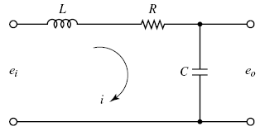
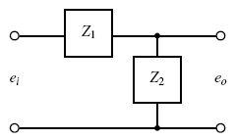
Example-3: repeat example-2 and obtain the TF using the Impedance Approach.
The first step is to transform this RLC circuit into the equivalent impedance form,
The transfer function, E_{o}(s)/E_{i}(s), can be obtain by applying the voltage-divider rule, hence

Slide 14
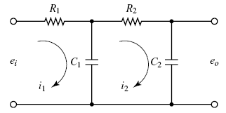
Example-4: Transfer Functions of Cascaded Elements.
Consider the system shown below. Assume that e_{i} is the input and e_{o} is the output.
The capacitances C1 and C2 are not charged initially.
It will be shown that the second stage of the circuit (R2C2 portion) produces a loading effect on the first stage (R1C1 portion).

Slide 15
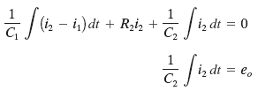
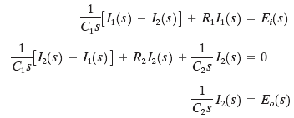
Example-4: Continue.
The equations for this system are;
(a)
(b)
(c)
Taking the Laplace transforms of Equations (a), (b) and (c), using zero initial conditions, we obtain
(d)
(e)
(e)

Slide 16
Example-4: Continue.
Eliminating I₁(s) from Equations (d) and (e) and writing E_{i}(s) in terms of I₂(s), we find the transfer function between E_{o}(s) and E_{i}(s) to be

Slide 17
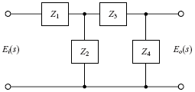
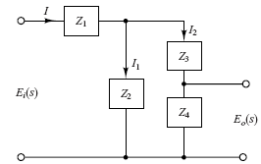
Example-5: repeat example-4 using the Impedance Approach.
Obtain the transfer function E_{o}(s)/E_{i}(s) by use of the complex impedance approach. (Capacitors C1 and C2 are not charged initially.)
(a)
(b)
The circuit shown in Figure (a) can be redrawn as that shown in Figure (b), which can be further modified to Figure (c).
(c)

Slide 18
Example-5: Continue.
In the system shown in Figure 3–10(b) the current I is divided into two currents I1 and I2 . Noting that

Slide 19
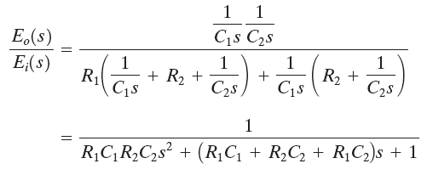
Example-5: Continue.
Substituting Z1 = R1, Z2 = 1/(C1S), Z3 = R2 , and Z4 = 1/(C2S) into this last equation, we get

Slide 20
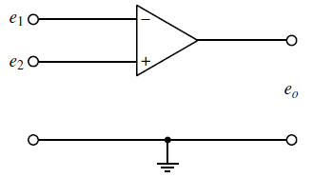
Operational Amplifiers (Op-Amps)
It is a common practice to choose the ground as 0 volt and measure the input voltages e₁ and e₂ relative to the ground.
The input e₁ to the minus terminal of the amplifier is inverted.
The input e₂ to the plus terminal is not inverted.
The total input to the amplifier thus becomes e₂ - e₁ .

Slide 21
Ideal vs. Real Operational Amplifiers:
In the ideal op amp, no current flows into the input terminals.
The output voltage is not affected by the load connected to the output terminal.
In other words, the input impedance is infinity and the output impedance is zero.
In an actual op amp, a very small (almost negligible) current flows into an input terminal and the output cannot be loaded too much.
The op amp amplifies the difference in voltages e₁ and e₂ .
Such an amplifier is commonly called a differential amplifier.
Since the gain, K, of the op amp is very high, it is necessary to have a negative feedback from the output to the input to make the amplifier stable.
The feedback is made from the output to the inverted input so that the feedback is a negative feedback.

Slide 22
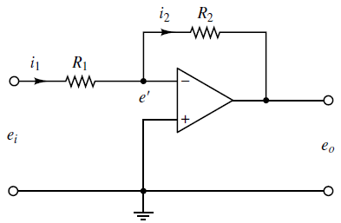
Inverting Amplifier:
Since only a negligible current flows into the amplifier, the current i1 must be equal to current i2 . Thus;
Since , hence we have;
Thus the circuit shown is an inverting amplifier. If R1 = R2 , then the op-amp circuit shown acts as a sign inverter.

Slide 23
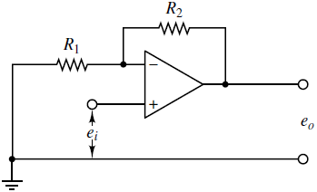
Non-inverting Amplifiers:
where K is the differential gain of the amplifier.
From this equation, we get
This equation gives the output voltage e_{o}. Since e_{o} and e_{i} have the same signs, this op-amp circuit is non-inverting.

Slide 24
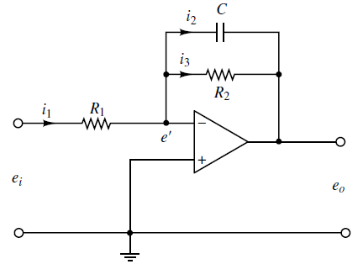
Example-6: Obtain the Transfer Function of the given inverting amplifier.
Noting that the current flowing into the amplifier is negligible, we have;
Hence
Taking the Laplace transform, we get
Hence the transfer function of this inverting amplifier is;

Slide 25
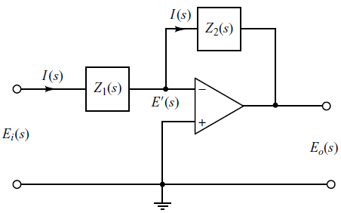
Obtaining the TF using Impedance Approach:

Slide 26
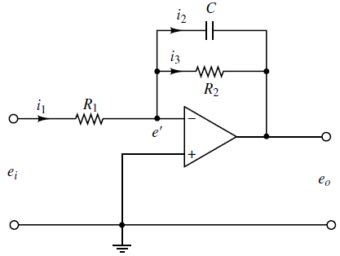
Example-7: repeat example-6 and obtain the TF by Impedance Approach.
The complex impedances Z1(s) and Z2(s) for this circuit are;
The transfer function E_{o}(s)/E_{i}(s) is, therefore, obtained as

Slide 27
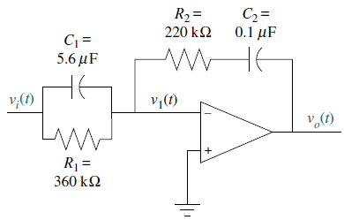
Example-8: Find the transfer function, V_{o}(s)/V_{i}(s).
The transfer function of the inverting amplifier circuit is given by
Since the admittances of parallel components add, Z1(s) is the reciprocal of the sum of the admittances, or
For Z2(s) the impedances add, or
The TF can be obtain by putting the values of Z1(s) and Z2(s) from eq (b) and (c) in eq (a).
Hence the transfer function after simplification is
(a)
(b)
(c)

Slide 28
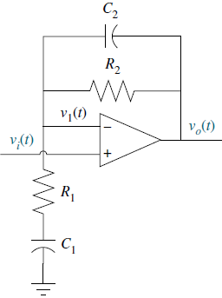
Example-9: Find the transfer function, V_{o}(s)/V_{i}(s).
The transfer function of the non-inverting amplifier circuit is given by
We find each of the impedance functions, Z1(s) and Z2(s), and then substitute them into TF equation (a) of non-inverting amplifier. Thus
(a)
(b)
(c)

Slide 29
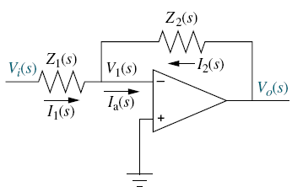
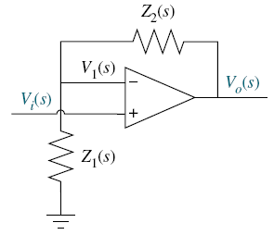
Skill-Assessment-2
PROBLEM: If Z1(s) is the impedance of a 10 µF capacitor, and Z2(s) is the impedance of a 100 kΩ resistor, find the transfer function, G(s) = V_{o}(s)/V_{i}(s), if these components are used with
An inverting operational amplifier as shown in Figure (a).
A non-inverting amplifier as shown in Figure (b).
Figure: (a)
Figure: (b)

Slide 30
ANSWER: Skill-Assessment-2
G(s) = - s for an inverting operational amplifier.
G(s) = s + 1 for a non-inverting operational amplifier.

