Slide 1
Biomedical Control Systems (BCS)
Module Leader: Dr Muhammad Arif
Email: muhammadarif13@hotmail.com
Please include “BCS-10BM" in the subject line in all email communications to avoid auto-deleting or junk-filtering.
Batch: 10 BM
Year: 3rd
Term: 2nd
Credit Hours (Theory): 4
Lecture Timings: Monday (12:00-2:00) and Wednesday (8:00-10:00)
Starting Date: 16 July 2012
Office Hour: BM Instrumentation Lab on Tuesday and Thursday (12:00 – 2:00)
Office Phone Ext: 7016

Slide 2
Signal Flow Graphs

Slide 3
Introduction:
Signal-flow graphs are an alternative to block diagrams.
Signal flow graphs are a pictorial representation of the simultaneous equations describing a system.
Signal flow graphs display the transmission of signals through the system, as does the block diagrams, but it is easier to draw and easier to manipulate than the block diagrams.
Unlike block diagrams, which consist of blocks, signals, summing junctions, and pickoff points, a signal-flow graph consists only of branches, which represent systems, and nodes, which represent signals.

Slide 4
Fundamentals of Signal Flow Graphs:
Consider a simple equation below and draw its signal flow graph:
X_{i} = A_{ij}X_{j}
The signal flow graph of the equation is shown below;
Every variable in a signal flow graph is designed by a Node.
Every transmission function in a signal flow graph is designed by a Branch.
Branches are always unidirectional.
The arrow in the branch denotes the direction of the signal flow.
The variables X_{i} and X_{j} are represented by a small dot or circle called a Node.
The transmission function A_{ij} is represented by a line with an arrow called a Branch.
The Node X_{i} is called input node and Node X_{j} is called output node.

Slide 5
Signal Flow Graph of Ohm’s Law:
The Ohm’s law state that E = RI, where
E is a voltage,
I is a current, and
R is a resistance.
The signal flow graph of the equation is given below;

Slide 6
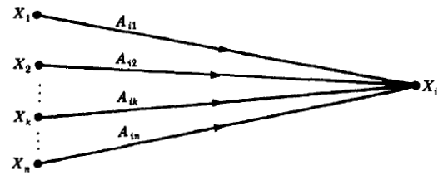
Signal Flow Graph Algebra:
1. The Addition Rule:
The value of the variable designated by a node is equal to the sum of all signals entering the node. This can be represented as;
Example: The signal flow graph for the equation of a line in rectangular coordinates, Y = mX + b, is given below. Since b is a constant it may be represent a node or a transmission function.

Slide 7
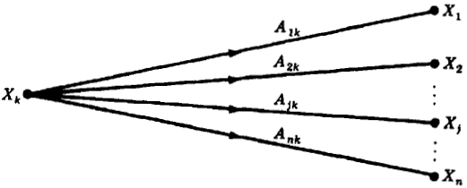
2. The Transmission Rule:
The value of the variable designed by a node is transmitted on every branch leaving that node.
Example: The signal flow graph of the simultaneous equations, Y = 3X, and, Z = -4X, is given in the figure below.

Slide 8
3. The Multiplication Rule:
A cascaded or series connection of n-1 branches with transmission functions , ,can be replace by a single branch with a new transmission function equal to the product of the old ones. That is
Example: The signal flow graph of the simultaneous equations Y = 10X, Z = -20Y, is given in

Slide 9
Terminologies:
An input node or source contain only the outgoing branches. i.e., X₁
An output node or sink contain only the incoming branches. i.e., X4
A path is a continuous, unidirectional succession of branches along which no node is passed more than ones. i.e.,
X1 to X2 to X3 to X4, X2 to X3 back to X2, X1 to X2 to X4, are paths.
A forward path is a path from the input node to the output node. i.e.,
X1 to X2 to X3 to X4, and X1 to X2 to X4, are forward paths.
A feedback path or feedback loop is a path which originates and terminates on the same node. i.e.; X2 to X3 and back to X2 is a feedback path.
A self-loop is a feedback loop consisting of a single branch. i.e.; A₃₃ is a self loop.
The gain of a branch is the transmission function of that branch when the transmission function is a multiplicative operator. i.e., A33
The path gain is the product of branch gains encountered in traversing a path. i.e.,
X1 to X2 to X3 to X4 is A₂₁A₃₂A₄₃
The loop gain is the product of the branch gains of the loop. i.e., the loop gain of the feedback loop from X2 to X3 and back to X2 is A₃₂A_{23.}

Slide 10
Converting Cascaded Block Diagram into a Signal Flow Graph:
First thing is to draw the signal nodes for the system.
Next thing is to interconnect the signal nodes with system branches.
The signal nodes for the system are shown in figure (a).
The interconnection of the nodes with branches that represent the subsystem is shown in figure (b).

Slide 11
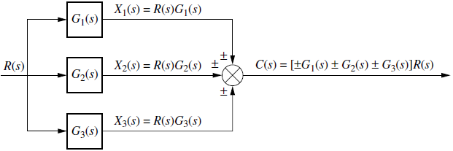
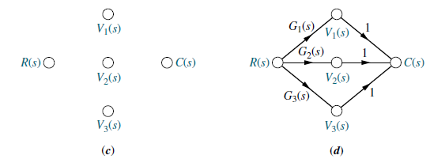
Converting Parallel System Block Diagram into a Signal Flow Graph:
First thing is to draw the signal nodes for the system.
Next thing is to interconnect the signal nodes with system branches.
The signal nodes for the system are shown in figure (c).
The interconnection of the nodes with branches that represent the subsystem is shown in figure (d).

Slide 12
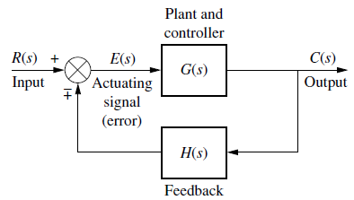
Converting Feedback System Block Diagram into a Signal Flow Graph:
First thing is to draw the signal nodes for the system.
Next thing is to interconnect the signal nodes with system branches.
The signal nodes for the system are shown in figure (e).
The interconnection of the nodes with branches that represent the subsystem is shown in figure (f).

Slide 13
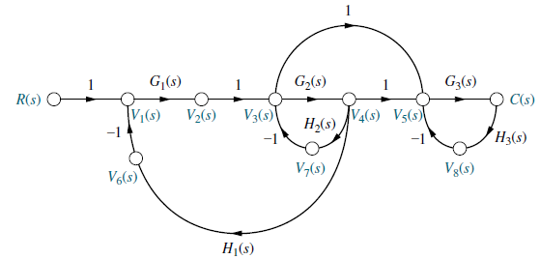
Example-1: Convert the block diagram into a signal flow graph:

Slide 14
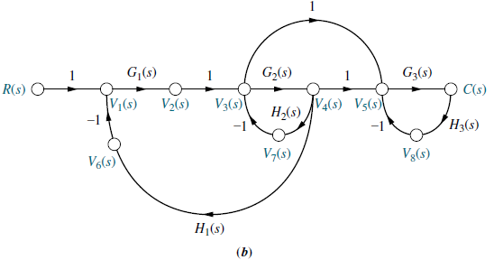
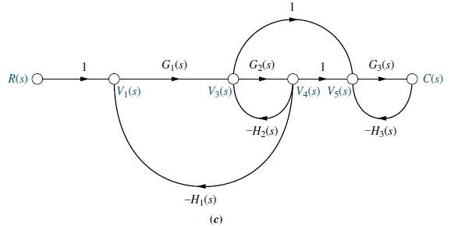
If desired, simplify the signal-flow graph to the one shown in Figure (c) by eliminating signals that have a single flow in and a single flow out, such as V2(s), V6(s), V7(s), and V8(s).

Slide 15
Example-2: Consider the signal flow graph below and identify the following;
Input node.
Output node.
Forward paths.
Feedback paths.
Self loop.
Determine the loop gains of the feedback loops.
Determine the path gains of the forward paths.

Slide 16
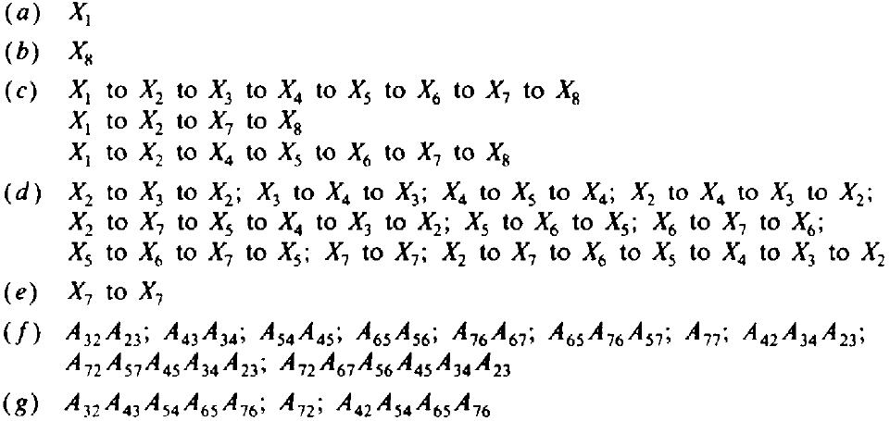
Example-2: Answers

Slide 17
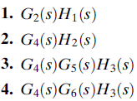
Example-3: Consider the signal flow graph below and identify the following;
There are four loop gains;
There are two forward path gains;
Nontouching loops;
1.
Nontouching loop gains;

Slide 18
Mason’s Rule (Mason, 1953)
The block diagram reduction technique requires successive application of fundamental relationships in order to arrive at the system transfer function.
On the other hand, Mason’s rule for reducing a signal-flow graph to a single transfer function requires the application of one formula.
The formula was derived by S. J. Mason when he related the signal-flow graph to the simultaneous equations that can be written from the graph.

Slide 19
Mason’s Rule:
The transfer function, T = C(s)/R(s), of a system represented by a signal-flow graph is;
Where
i = number of forward paths.
P_{i} = the i th forward-path gain.
P_{jk} = j th possible product of k nontouching loop gains.
∆ = 1 - ∑P_{j1} + ∑P_{j2} - ∑P_{j3} +…..
= 1 - ∑ loop gains + ∑ gain products of two nontouching loops - ∑ gain products of three nontouching loops + . . .
∆_{i} = ∆ - ∑ loop gain terms in ∆ that touch the i th forward path: In other words;
∆_{i} is formed by eliminating from ∆ those loop gains that touch the i th forward path.
Two loops, paths, or loop and a path are said to be nontouching if they have no nodes in common.
∆ is called the signal flow graph determinant or characteristic function. Since ∆=0 is the system characteristic equation.

Slide 20
Example-4: Construct the signal flow graph of the block diagram of the canonical feedback control system and find the control ratio C/R.
The characteristic function
Since the loop touch the forward path

Slide 21
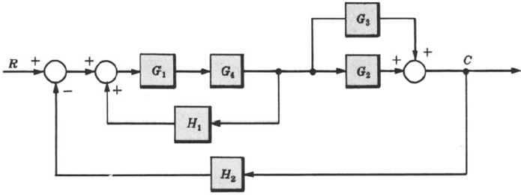
Example-5: Determine the control ratio C/R and the canonical block diagram of the feedback control system.

Slide 22
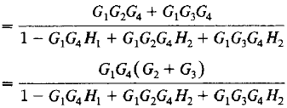
Example-5:Continue. (finding the control ratio C/R )

Slide 23
Example-5:Continue. (finding the canonical block diagram)

Slide 24
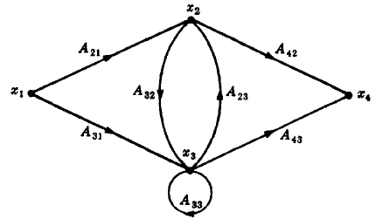
Example-6: Construct the signal flow graph for the following set of simultaneous equations.
There are four variables in the equations (i.e., x1,x2,x3,and x4) therefore four nodes are required to construct the signal flow graph.
Arrange these four nodes from left to right and connect them with the associated branches.
Another way to arrange this graph is shown in the figure.

Slide 25
Example-7: Determine the transfer function C/R for the block diagram below by signal flow graph techniques.
The signal flow graph of the above block diagram is shown below.
There are two forward paths. The path gains are
The three feedback loop gains are
No loops are non-touching, hence
Because the loops touch the nodes of P1, hence
Hence the control ratio T = C/R is
Since no loops touch the nodes of P2, therefore

Slide 26
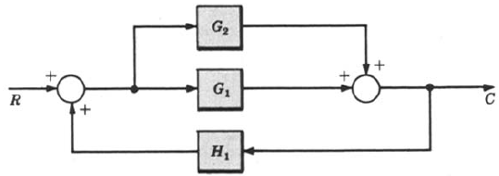
Example-8a: Determine C/R of each of the following system using the signal flow graph techniques.
The signal flow graph of the block diagram is shown below.
The two forward paths gains are
No loops are non-touching, hence
The two feedback loop gains are
Because both paths touch the feedback loops at both interior nodes , hence
Hence the control ratio is T =

Slide 27
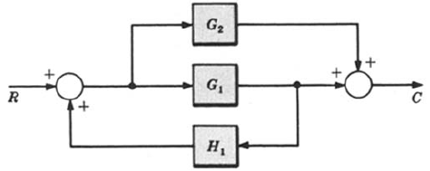
Example-8b: Determine C/R of each of the following system using the signal flow graph techniques.
The signal flow graph of the block diagram is shown below.
No loops are non-touching, hence
The two forward paths gains are
The forward path through G1 clearly touches the feedback loop at nodes a and b; thus ∆1 = 1.
There is only one feedback loop gain is
The forward path through G2 touches the feedback loop at node a; then ∆2 = 1.
Hence the control ratio is T =

Slide 28
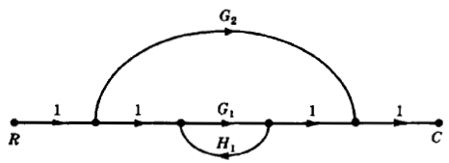
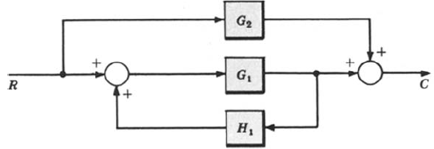
Example-8c: Determine C/R of each of the following system using the signal flow graph techniques.
The signal flow graph of the block diagram is shown below.
No loops are non-touching, hence
The two forward paths gains are
The forward path through G1 clearly touches the feedback loop thus ∆1 = 1.
The only feedback loop gain is
The feedback path does not touch the forward path through G2 at any node; therefore ∆2 = ∆ = 1 – G1H1.
Hence the control ratio is T =

Slide 29
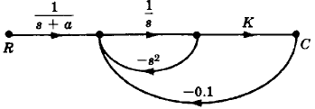
Example-9: Find the transfer function C/R for the system in which k is constant.
The only forward path gain is
The signal flow graph is shown in the figure.
The two feedback loop gains are
There are no non-touching loops, hence
Hence the control ratio T is
Both feedback loops touches the forward path, hence

Slide 30
Example-10: Find the control ratio C/R for the system given below.
The signal flow graph is shown in the figure.
The two forward path gains are
The five feedback loop gains are
There are no non-touching loops, hence
All feedback loops touches the two forward paths, hence
Hence the control ratio T =

Slide 31
Example-11: Determine C/R for the system given below using signal flow graph techniques and then put G3 = G1G2H2.
The signal flow graph of the above block diagram is shown in the figure below.
The only forward path gain is
There are no non-touching loops, hence
The only feedback loop gain is
The feedback loop clearly touches the two forward paths, therefore
Hence the control ratio T =

